Slide 1
Developing New Library Business Models for e-Books: The Beyond Print Initiative at the Triangle Research Libraries (TRLN)
Hsi-Chu Bolick 黄熹珠, Librarian for East Asian Studies
University of North Carolina at Chapel Hill
Luo Zhou 周珞, Chinese Studies Librarian
Duke University
Committee on Chinese Materials, CEAL Toronto, Canada
3/15/2012

Slide 2
TRLN Consortia The Triangle Research Libraries Network (TRLN) - 1930s: The University of North Carolina at Chapel Hill (UNC) and Duke University began cooperating on developing research level collections & shared library services - 1950s + North Carolina State University - 1995 + North Carolina Central University - 1960s - present UNC and Duke cooperate on Chinese and Japanese collections development and library services
Committee on Chinese Materials, CEAL Toronto, Canada
3/15/2012

Slide 3
TRLN: Beyond Print Initiative Beyond Print is an Andrew W. Mellon funded project to develop new business models and licensing for cooperative acquisitions for ebooks. Why: - TRLN’s proud cooperative history that has stressed resource sharing since the 1930s - In the e-publishing environment both publishers & libraries are struggling to figure out fair business practices for a format that is quickly evolving
Committee on Chinese Materials, CEAL Toronto, Canada
3/15/2012

Slide 4
TRLN collaboration goal
TRLN United: Continue the One Collection, One Community tradition begun in the 1930’s
The core idea sustaining TRLN’s long cooperation:
“If cooperation is to succeed, it must emphasize institutional advancement and enhanced service to users”.
Committee on Chinese Materials, CEAL Toronto, Canada
3/15/2012
Notes:
When in the 1960s, UNC and Duke began to develop its own East Asian collection, cooperation and resource sharing were seeded deeply like part of the genetic makeup

Slide 5
E-book Context
But what about?
Principle of cooperative collection development and resource sharing
Current complicated rights environment
Financial and workflow issues
• Access
Search
Save space
Committee on Chinese Materials, CEAL Toronto, Canada
3/15/2012

Slide 6
Action
TRLN Beyond Print Summit August 2011
Who: Cohort of Librarians, Publishers, E-book Vendors
What: Resource sharing, acquisition options and cost focus
From Anecdote to Data
TRLN analyzed two sets of approval plan orders from YBP: July 2007 – July 2010 (three years) & August 2010 – May 2011 (nine months)
Analyzed using SAS, MySQL database, Excel, and manual verification
Committee on Chinese Materials, CEAL Toronto, Canada
3/15/2012

Slide 7
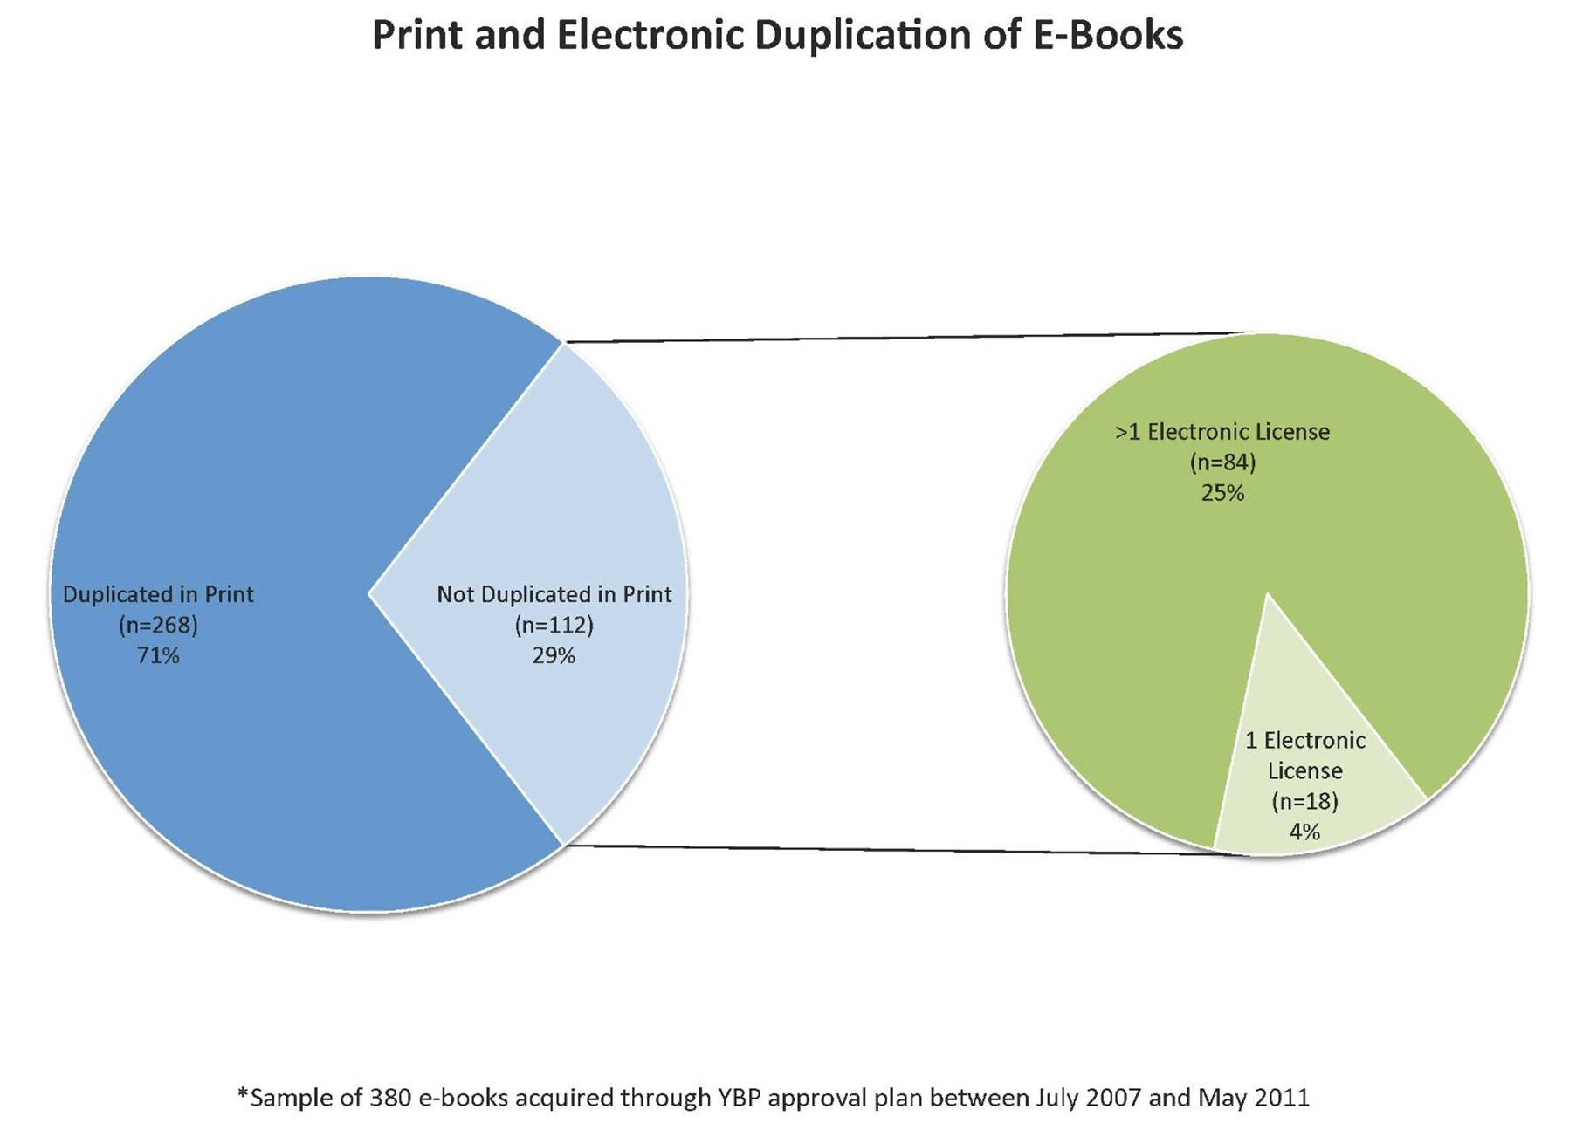
TRLN Collection Overlap
TRLN libraries buy only one copy of a title more than 50% of the time and two or fewer copies
more than 80% of the time.
Eight publishers account for 30% of the overlap between all three institutions.
An estimated 71% of e-books are duplicated in print by at least one institution
Of the estimated 29% of titles not duplicated in print, 84% are licensed as e-books by multiple institutions

Slide 8
What Libraries Want
Flexible acquisitions options, including title-by-title selection
Integration of e-book purchasing into acquisitions workflow
Support for resource sharing
Transparency about availability of electronic materials
Preservation assurances
Clearer and less limiting application of digital rights management (DRM)
Committee on Chinese Materials, CEAL Toronto, Canada
3/15/2012

Slide 9
TRLN: Beyond Print | Commonalities and Gaps
LIBRARIANS,
VENDORS,
CONSORTIAL
AGGREGATORS,
COLLEAGUES
PUBLISHERS
Sharing and Networks
permanent access, provide temporary access to consortia members and to external libraries
Ownership does not necessarily include “permanent access,” and does not allow the owner to provide temporary access
Avoid operational words like “ILL.” “Access,” “resource sharing,” and “temporary access” are more descriptive
Acquisitions Options
Lease-to-own models should be offered
multiple models: title-by-title selection, DDA, lease-to-own, packages
Integration with book vendors (workflow, ordering information, e and p duplication)
Simultaneous publication of p and e,
preferably e first
Transaction costs are low in short-term loan environment, & justify full price purchase
SERU in lieu of license?
Simplify licensing language and paperwork, not necessarily SERU
Cost Models
industry standards for
e-book usage and purchase triggers
Industry standards are not feasible in current market
Need transparent terminology
investment in p should be considered by publishers in pricing e
offer deep discounts for print with purchase of e-book and vice versa
Explore pricing options for short-term loans, and use-based pricing
Notes:
SERU: Shared E-resources Understanding

Slide 10
Initial Frameworks: Business Models
Two business model frameworks
Core collection at negotiated multiplier
Individual purchase (user-driven or selected)
one copy in consortia with consortial access triggers additional fees based on use thresholds to cap
Short-term loans that build to purchase (lease-to-own)
ILL based on artificial scarcity
Devilish details:
Reasonable cap/threshold for consortia.
What is fair short-term loan cost? (Percentage of purchase price?)
What is fair level of artificial scarcity?
Infrastructure to execute both.
Committee on Chinese Materials, CEAL Toronto, Canada
3/15/2012

Slide 11
Moving Forward
Pilots/discussions underway
Beyond Print discussion
Significant consortia interest in sharing/access of ebooks
Moving forward with pilots and experimentation.(Ebrary)
Data driven approach
Consideration of ILL costs
Data allows informed discussions with publisher partners
Committee on Chinese Materials, CEAL Toronto, Canada
3/15/2012

Slide 12
Thank you!
His-Chu Bolick 黄熹珠, bolick@email.unc.edu
Luo Zhou 周珞，luo.zhou@duke.edu
Committee on Chinese Materials, CEAL Toronto, Canada
3/15/2012

