Slide 1
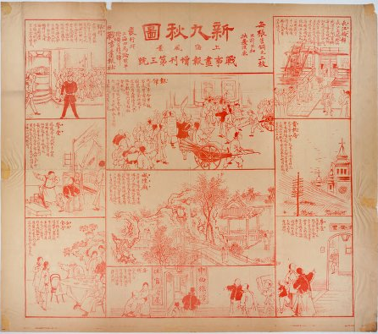
Late Qing – Minguo Periodicals
Martin J. Heijdra, Princeton University
Forum on Chinese Digital Content, CEAL, Toronto, March 14, 2012

Slide 2
Late Qing – Minguo Periodicals
1 Quan guo bao kan suo yin databases
2 Da cheng lao jiu kan database

Slide 3
Late Qing – Minguo Periodicals
Quan guo bao kan suo yin databases:
1 Index database. Currently at http://www.cnbksy.com/
Full-image databases. Currently at http://www.cnbksy.cn/
Late Qing (1833-1911) periodical literature: Wan-Qing qi kan quan wen shu ju ku
Republican period (1911-1949) periodical literature: Minguo shi qi qi kan quan wen shu ju ku

Slide 4
Late Qing – Minguo Periodicals
While these three image databases (Wan-Qing qi kan, Minguo shi qi qi kan, and the Da cheng lao jiu kan) all are called quan wen shu ju ku 全文数据库 in Chinese, they do not contain OCR’d articles, and are not full-text searchable. I call them in our local literature “full-image” databases

Slide 5
Late Qing – Minguo Periodicals
The Quan guo bao kan suo yin databases:
Currently the index database and the various full-image databases are not yet integrated; integration is planned for 2012
Thus, the index database does not show which articles are scanned; and the full-image databases do not include article titles which are not scanned
Integration will take place on the new platform, now used for the full-image databases only

Slide 6
Late Qing – Minguo Periodicals
The Quan guo bao kan suo yin index database:
The index databases include more than 30 million citations from over 20,000 sources, from 1833 onwards. We have the pian ming shu ju ku 篇名数据库 series; there exist a few more specialized ones (conferences, etc.) we did not purchase
The index databases include a Document Delivery Service (DDS), which in our case is set up in such a way that staff intervention is required to finalize requests. We do occasionally request articles, but in practice, many items can be found in our or other libraries

Slide 7
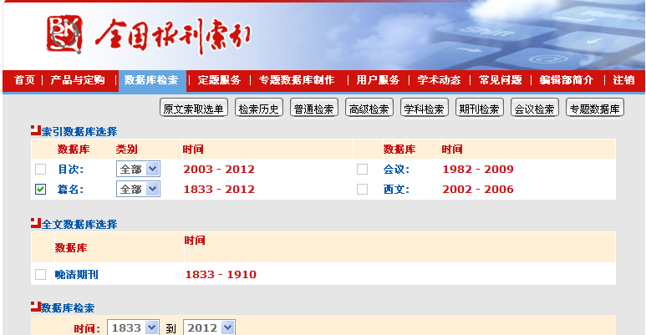
Late Qing – Minguo Periodicals
The Quan guo bao kan suo yin index database:

Slide 8
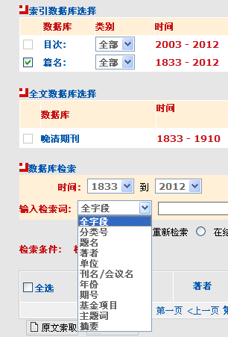
Late Qing – Minguo Periodicals
The Quan guo bao kan suo yin index database:
Indexing is very thorough and detailed:
many articles are not even page-length
(but can be important to researchers)
A large array of search parameters is
provided

Slide 9
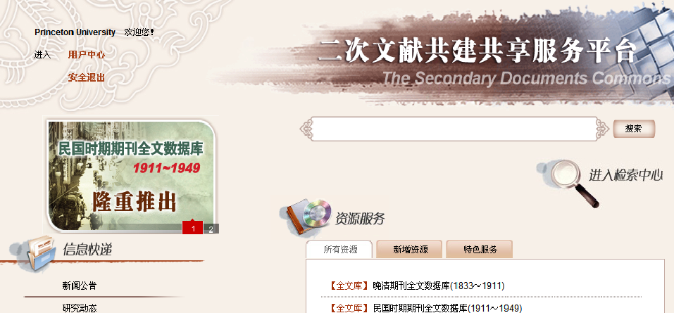
Late Qing – Minguo Periodicals
The Quan guo bao kan suo yin image databases:

Slide 10
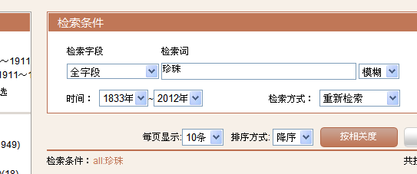
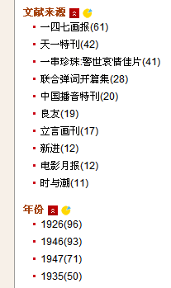
Late Qing – Minguo Periodicals
The Quan guo bao kan suo yin image databases:
Simple, advanced and
professional search modes
are provided (shown is
the simple box)
Results can be refined by a few facets (database,
journal title, year), refined within results, expanded,
and sorted by relevance, year (latest to oldest) or title
Authors and journal titles in result are hyperlinked

Slide 11
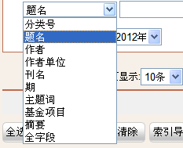
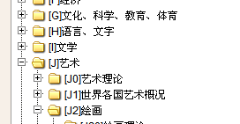
Late Qing – Minguo Periodicals
The Quan guo bao kan suo yin image databases:
Indexes are very detailed and thorough, and include photographs and captions (read the right way, even if originally going from right to left!)
Searching (fuzzy or exact; in title, author, journal title, subject classification number, extra keywords…) can be done in simplified and traditional characters; but interface etc. is in simplified characters

Slide 12
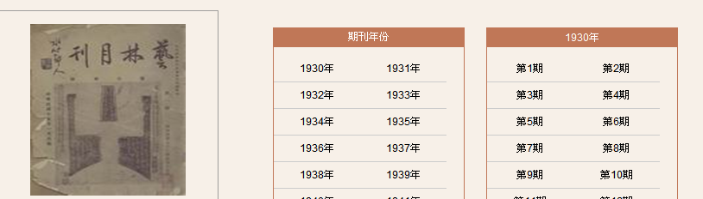
Late Qing – Minguo Periodicals
The Quan guo bao kan suo yin image databases:
Browsing is possible
Individual results downloadable in pdf; limit of 20 in downloading result citations

Slide 13
Late Qing – Minguo Periodicals
The Quan guo bao kan suo yin databases, some figures:
Index database: 30 million entries
Late Qing: 290,000 scanned articles (citations: 460,000) , from >300 periodicals
Republican period: target is 20,000 periodicals, 15 million articles. Currently available : parts 1-4: 5,630 journal titles, >120,000 issues, >3.2 million articles (in citations: >6.2 million). To come: Dian shi zhai hua bao, North China Herald/ North China Daily News (browse versions)

Slide 14
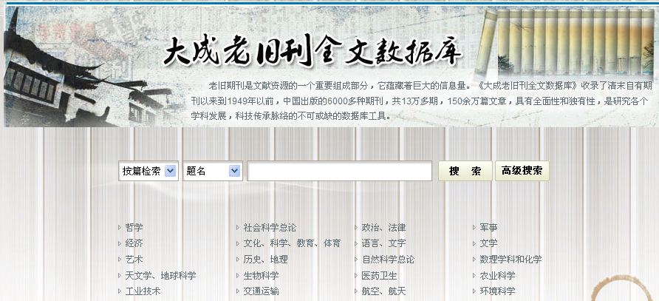
Late Qing – Minguo Periodicals
Da cheng lao jiu kan database:

Slide 15
Late Qing – Minguo Periodicals
Da cheng lao jiu kan database:
From 1840 to 1949; at www.dachengdata.com
Current numbers: >7,000 journal titles, 130,000 issues, 1.3 million article titles
Planned upgrades of 10,000 issues/year, and soon: additional journal introductions

Slide 16
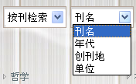
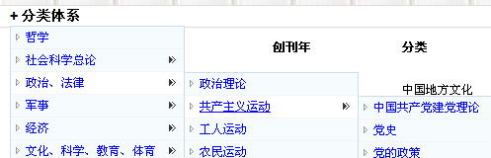
Late Qing – Minguo Periodicals
Da cheng lao jiu kan database:
Searchable by article (titles, author, journal title) and journal (title, year, place, organization) in simplified and traditional characters (but highlighting in result is only of the exact form used)
Browsing of journal titles, not articles, possible by subject; not part of combined search

Slide 17
Late Qing – Minguo Periodicals
Da cheng lao jiu kan database:
From a result, one can view the article (viewer jumps to page in issue), re-search author, browse journal, and browse issue ; and refine search within results
Articles do not give page numbers; (partial work-around: click on issue; but the table of contents is not always in order!)

Slide 18
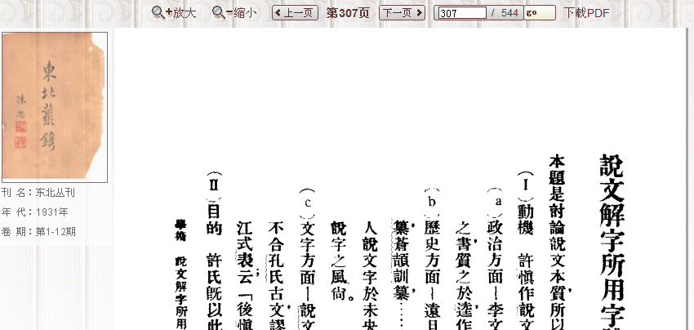
Late Qing – Minguo Periodicals
Da cheng lao jiu kan database:
What is shown and downloadable is usually a unit many pages more than the specific article

Slide 19
Late Qing – Minguo Periodicals
Da cheng lao jiu kan database:
Browsing possible by journal

Slide 20
Late Qing – Minguo Periodicals
Some issues:
Quan guo bao kan suo yin
Subject searches can only be incorporated using subject classification numbers, not facets or words
More facets desirable (authors, places, subjects, other keywords), and facets should be expandable beyond 10 largest hits; closing a facet is rather hidden
Parts of interface under construction, but this is not always clear
The yonghu zhongxin 用戶中心 function (with e.g. search history) provided refers in the case of IP access to the institution, not an individual
Da cheng lao jiu kan
Limited search capabilities
Results presented for viewing and downloading are often more than article in question; page numbers are almost impossible to get
Subjects not usable in searches, and only pertain to journal titles
Sometimes wrong hits (wrong OCR?)

Slide 21
Late Qing – Minguo Periodicals
Some comparisons:
(From a now outdated and necessarily incomplete comparison we received in May 2011 from colleagues at the Staatsbibliothek zu Berlin :)
46% of the titles (not issues) in the first 3 parts of the Quan guo bao kan suo yin were also held in Da cheng
16% of the titles (not issues) in Da cheng were also held in the first 3 parts of the Quan guo bao kan suo yin
At that time, holdings in Da cheng were much more incomplete than in the Quan guo bao kan suo yin, and search capabilities were (and are) less refined

Slide 22
Late Qing – Minguo Periodicals
Some comparisons (using word-in-title searches):
Real-life example 1 : one of our users is writing his dissertation on Robert Lim Ko-Sheng (1897-1969), a Singaporean-born medical doctor active in pre-1949 China
Quan guo bao kan suo yin gives 26 articles, reflecting his writings, his appointments, his speeches
Da cheng has only 5 articles, but includes important communist articles attacking him
Only 2 articles overlap
Real-life example 2: another students writes on pearls:
Quan guo bao kan suo yin gives 681 articles (many literature)
Da cheng has 72 articles (many literature)
At most only 17 articles overlap; even if same journal is indexed, issues may not overlap (at least currently)

Slide 23
Late Qing – Minguo Periodicals
Some conclusions:
Keep in mind that the databases index differently; hence, even if they would include the same issue, results could be different!
There are not many outside indexes for this period; hence users will often use these databases to discover items, not to search for known article titles
In practice, while currently the number of journal titles is larger in Da cheng, the number of articles is much larger in the Quan guo bao kan suo yin, and the latter’s indexing and search capabilities are much more refined; our users report very complementary, and not many overlapping results

Slide 24
Late Qing – Minguo Periodicals
Purchase models:
Quan guo bao kan suo yin
Contact Gabrielle Xu (Xu Shu) at Shanghai Library (bksy3@libnet.sh.cn )
Late-Qing database purchasable as one set (payment in installments possible); Minguo database purchasable in different batches
Some discount available if indexes to those parts have already been purchased
Official prices: Late-Qing $78,000; Minguo: $19,000/batch. Current discount prices for batches 1-3: $8,000
Da cheng lao jiu kan
Contact Zhang Aizhen at Superstar (haiwai@ssreader.com)
Purchase model, but price can be divided into 5 installments (after purchase, maintenance fee)
If 5 installments, each installment $8,000, $12,000 or $15,000 depending on the size of the library (if paid in one go, discount of 10%)
Consortia possible, with installments per library of $7,000, $9,000 or $15,000

Slide 25
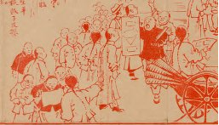
Late Qing – Minguo Periodicals
What is this red background?
It’s an image from our “Block prints from the Chinese revolution,” collection, 30 news sheets announcing the 1911 Wuhan events to the Shanghai public as they unfold. The collection has been digitized, and since some images were used in a recent Hong Kong Museum of History exhibition, they have proven quite popular.
This particular image is from the
Zhan shi hua bao, zeng kan 3,
and shows a vendor of such
material.

