Slide 1
Overall Publishing Trends in Chinese Scholarly Resources
Li Wang, Ph.D.
Brown University
CEAL-CCM Annual Meeting
Toronto, Canada
March 15, 2012

Slide 2
Topics:
Flourishing Chinese Publishing Landscape
Key Successful Efforts and Challenges for Sustainable Development
Digital Publishing, e-Books, and Mobile Libraries
Implications to East Asian Libraries in North America

Slide 3
I. Flourishing Chinese Publishing Landscape
Amplification of the Scale and Outputs of Publishing Industry
Increasing Popularity of Digital Publishing and Mobile Networks
Improvement of the Book Import and Export and Copyright-Trade

Slide 4
Amplification of the Scale and Outputs of Publishing Industry Outputs of Publishing Industry in China 2010
581 official publishing house
328,387 books
189,295 new books
374 audio-video publishing houses
251 digital/network publishers
167,882 distribution entities
9,884 periodicals
1,937 newspapers
45.2 billion newspaper circulation
1,260 billion RMB (US$196.7 billion) media-publishing revenue
Source: General Administration of Press and Publication (GAPP) statistics 2010

Slide 5
Outputs of Publishing Industry of China (2000-2010)
 | Book Publishers | Books (New Prints) | Periodicals | Newspapers | A-V Materials | E-resources
2010 | 581 | 328,387 (189,295) | 9,884 | 1,939 | 21,552 | 11,175
2009 | 580 | 301,719 (168,296) | 9,851 | 1,937 | 25,384 | 10,708
2008 | 579 | 275,668 (149,988) | 9,549 | 1,943 | 23,493 | 9,668
2007 | 579 | 248,283 (136,226) | 9,468 | 1,938 | 31,955 | 8,652
2006 | 573 | 233,971 (130,264) | 9,468 | 1,938 | 33,706 | 7,207
2005 | 573 | 222,473 (128,578) | 9,468 | 1,931 | 34,961 | 6,152
2004 | 573 | 208,294 (121,597) | 9,490 | 1,922 | 34,323 | 6,081
2003 | 570 | 190,391 (110,812) | 9,074 | 2,119 | 28,224 | 4,961
2002 | 568 | 170,962 (100,693) | 9,029 | 2,137 | 25,872 | 4,713
2001 | 562 | 154,526 (91,416) | 8,889 | 2,111 | 20,971 | 2,396
2000 | 565 | 143,376 (84,235) | 8,725 | 2,227 | 17,648 | 2,249
Sources: GAPP statistics 2000-2010

Slide 7
New Books Published with ISBN in Mainland China 2009
Subjects | Titles (New Prints) | % | Notes
Philosophy & Marxism | 5,186 | 2.90
General Social Sciences | 2,703 | 1.52
Politics & Law | 10,967 | 6.86
Military Science | 709 | 0.34
Economics | 16,872 | 10.11
Culture, Science, Education, Sports | 41,227 | 24.90
Languages & Linguistics | 8,848 | 5.30
Literature | 18,132 | 9.80
Art | 9,652 | 5.91
History & Geography | 8,528 | 5.22
Medicine & Health | 9,507 | 5.66
Sciences, Technologies & Others | 34,132 | 20.64
General Works | 1,323 | 0.84
Total | 167,786 | 100

Slide 8
New Chinese Book Publishing (2007)
Mainland: 136,226
Hong Kong: 14,136
Taiwan: 42,018
Total: 192,380

Slide 10
Growth of Electronic Publishing and Mobile Networks in China
900+ million mobile phone users
513 million Internet users (“netizens”)
356 million mobile Internet users
36.2% Internet penetration rate
10,708 electronic publishing products
500,000+ e-books produced
700,000 e-book readers sales
$11,735 million digital publishing revenue
Source: GAPP statistics 2010; CNNIC Statistical Survey Report (Jan. 16, 2012)

Slide 11
Sources: China Internet Network Information Center (CNNIC): The 29th Statistical Survey Report on the Internet
Development in China (Jan. 16, 2012)
网易科技: http://tech.163.com/special/cnnic29/

Slide 12
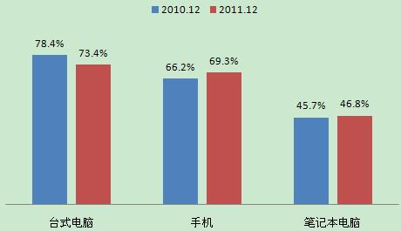
Trends of Computer Usage 2009-2010
Desktop PC
Mobile Phone
Laptop PC
Sources: 中国互联网数据平台 http://www.cnidp.cn/

Slide 13
Improvement of the Book Import and Export and Copyright-Trade Comparison Rankings of Import Partners
Ranking | Country/Region | 2007 | 2008 | 2009
1 | US | 3,878 | 4,011 | 4,533
2 | UK | 1,635 | 1,754 | 1,847
3 | Taiwan | 892 | 6,040 | 1,444
4 | Japan | 822 | 1,134 | 1,261
5 | South Korea | 416 | 755 | 799
6 | Germany | 585 | 600 | 693
7 | France | 393 | 433 | 414
8 | Hong Kong | 268 | 195 | 398
9 | Singapore | 228 | 292 | 342
10 | Canada | 33 | 59 | 73

Slide 14
Comparison Rankings of Export Partners
Ranking | Country/Region | 2007 | 2008 | 2009
1 | Taiwan | 630 | 603 | 682
2 | US | 196 | 122 | 267
3 | South Korea | 334 | 303 | 253
4 | UK | 109 | 45 | 220
5 | Hong Kong | 116 | 397 | 219
6 | Germany | 14 | 96 | 173
7 | Japan | 73 | 56 | 101
8 | Singapore | 171 | 127 | 60
9 | Russia | 100 | 115 | 54
10 | France | 50 | 64 | 26

Slide 15
II. Key Successful Efforts and Challenges for the Sustainable Development
Successful Efforts and Experience
Advocating Strategic Viewpoint to Envision the Cultural-Publishing Enterprise
Deepening Structural Reform and Implementing Corporative Reorganizations
Enhancing Standardization and Regulations for Healthy and Productive Outcomes
Advancing Going-Out Policy for International Cooperation
Promoting Reader Services and Expanding Cultural Markets

Slide 16
Advocating Strategic Viewpoint to Envision the Cultural-Publishing Enterprise
Central Committee of the Chinese Communist Party Decision Concerning Deepening Cultural Structural Reform (Oct. 18, 2011)
中共中央关于深化文化体制改革的决定（2011年10月18日)

Slide 17
Challenges and Problems for Sustainable Development
Enhancing the operation and profits of the new corporative organizations
Improving quality of the publications
Coping with issues on intellectual freedom and censorship
Protecting copyright against piracy

Slide 18
III. Digital Publishing, e-Books, and Mobile Libraries
National Library of China’s New Buildings & Digital Library

Slide 19
China Academic Social Sciences and Humanities Library (CASHL)
http://www.cashl.edu.cn/portal/index.jsp

Slide 20
Taiwan National Digital Archives Program
http://www.ndap.org.tw/index_en.php

Slide 21
Hong Kong E- Version of Siku Quanshu
Source: Angela Ko, “E-Publishing in Hong Kong”, the presentation at the first Sino-American Academic Library Forum, Xiamen University, Sept. 2011

Slide 22
四库全书电子化工程
工程始于1996年; 投资人: 余志明
1998年推出光盘版; 2000年提升为全文检索版; 同年推出网络版;不断推出加强版
最新发展 (09-15-2011):
邀饶宗颐领衔主编四库电子版
香港大学饶宗颐学术馆负责主持，并组织专家団队编纂
迪志文化负责技术支持、网站及数据库管理
陆续增补古今中外材料，把陶文、甲骨文、金文、石刻文字等文字编进去，成为一本涵盖中华历代文字，又具有时代价值的网上字典
第一阶段要完成以辅助使用「四库全书电子版」为目的的电子字典

Slide 23
Versions of e-Books
A book that has been converted to digital form and can be read on a computer, usually via network services or CD-ROM. Electronic books can expand on print media by adding hypertext links, search and cross-reference functions, and multimedia. The term refers to:
(1) e-Book Content
(2) e-Book Readers
(3) e-ook Software
《2011中国电子书产业研究报告》发布 1月9日，由北京图书订货会组委会和百道网联合主办的电子书产业峰会上，首次发布了《2011中国电子书产业研究报告》。 报告中将电子书分为三种基本类型：电子书1.0 即传统印刷图书对应的电子版；电子书2.0 即从生产到发布都只有数字化形态的电子读物；电子书3.0即集成了多种要素的多媒体读物。

Slide 24
http://www.gapp.gov.cn/cms/html/21/508/201010/704088.html

Slide 25
Mobile Library
Goals of 5As:
Any user
Any time
Anywhere
Any library
Any information resource

Slide 26
Sample e-Book Production/Dissemination Models
PC/Mac
Model A
Digital Library
Cell phone
Publisher
Tech Provider
Access platform
Smart phone
User
Content
Format/tech support
Kindle reader
Website / E-Book Distributor
Model B
Ipad
Publisher
Other devices
Content/format/tech support

Slide 27
SuperStar Digital Library 超星数字图书馆
超星发展的移动图书馆通过设置个人空间与图书馆OPAC系统的对接，使用手机或移动设备登录，实现了馆藏查询、续借、预约、挂失、到期提醒、热门书排行榜、咨询等自助式移动服务。并可以自由选择咨询问答、新闻发布、公告（通知）、新书推荐、借书到期提醒、热门书推荐、预约取书通知等信息交流功能。
还专门提供3万多本e-pub电子图书, 7800多万篇报纸全文供手机用户阅读使用。提供215万种中文电子图书、9亿页全文资料的文献传递，内容涉及文学、历史、哲学、医学、旅游、计算机、建筑、军事、经济、金融和环保等数字图书资源。

Slide 28
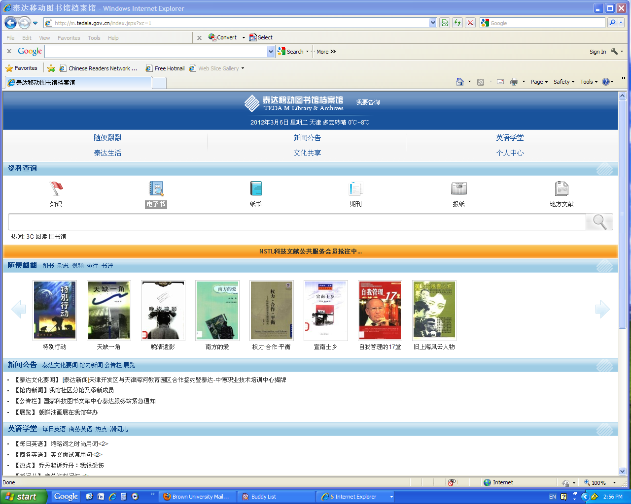
Tianjin TEDA Mobile Library 天津泰达移动图书馆

Slide 29
Build a New Model to Access to knowledge in the Goble Information Age
Launching Ceremony for the TEDA Mobile Library in Tianjin, Sept. 27, 2012
TEDA is the acronym of Tianjin Economic-Technological Development Area

Slide 30
方正Apabi数字图书馆
方正Apabi数字图书系统由北大方正电子有限公司制作，收录了全国400多家出版社出版的最新中文图书，绝大部分为2000年以后出版的，并与纸质图书同步出版。

Slide 31
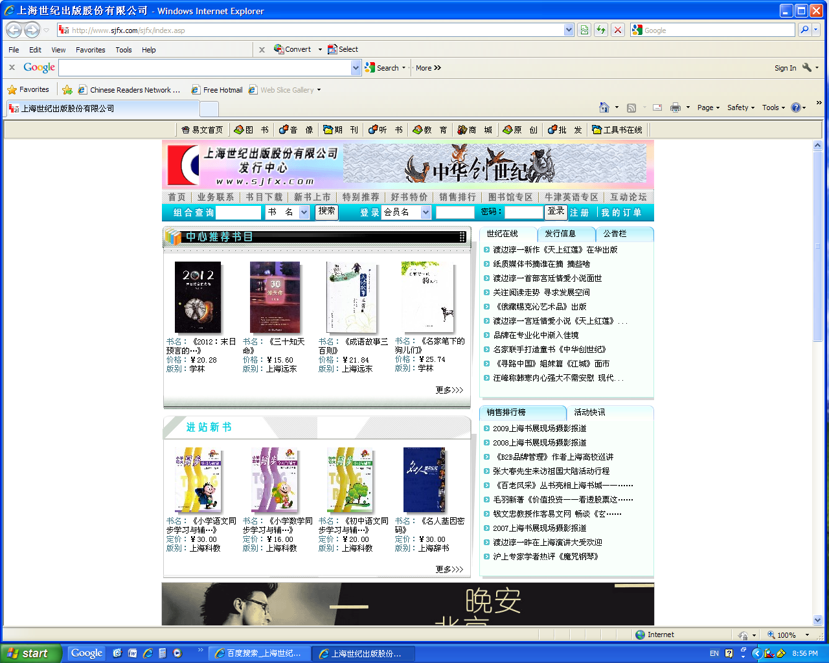
上海世纪出版股份有限公司
http://www.ewen.cc/sjfx/

Slide 32
汉王电纸书
http://www.hw99.com/

Slide 33
盛大文学
http://www.sd-wx.com.cn/

Slide 35
台湾华艺数位电子书
http://www.airitibooks.com/

Slide 36
Sample Mobile Libraries
北京书生公司 http://www.sursen.com
北京大学移动图书馆http://wap.lib.pku.edu.cn
清华大学移动数字图书馆 http://lib.tsinghua.edu.cn/m
复旦大学移动图书馆 http://mlib.fudan.edu.cn

Slide 37
Source: http://wenku.baidu.com/view/18bbf10eba1aa8114431d974.html

Slide 38
Sample Flowchart for Mobile Library Users
注册账号 User Account Registration
馆藏图书检索 Library Book Search
电子资源检索 E-resource Search
个人中心 Personal Center

Slide 39
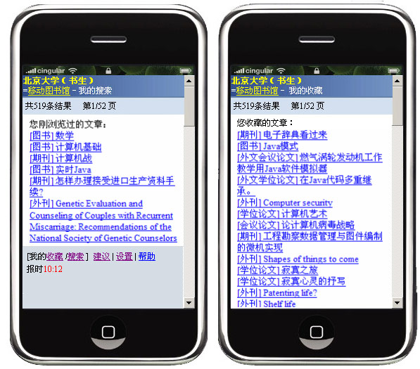
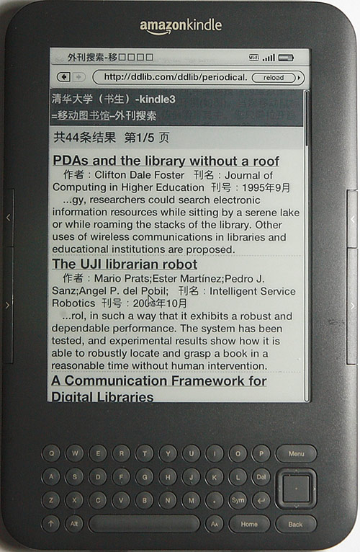

Slide 40
IV. Implications to East Asian Libraries in North America
Source: Culture and Art from the Divine Land: An Exhibition of Chinese Collections来自神州大地的文化艺术--布朗大学中文馆藏特展 John Hay Library, Brown University, Feb. 6-March 31, 2012

Slide 41
Implications to East Asian Libraries in North America
The overall growth of East Asian/Chinese library collections to a great extent relies on the development of Chinese publications available in the scholarly resources market.
There will be a considerable increase of Chinese e-books along with other types of digital products, including databases, e-journals, and A-V materials, besides the print books in the EA libraries/collections.
It is time to let library administration know the fact of the booming publishing trends in order to gain more possible financial and staffing support. At least we can make a stronger justification for the survival of our collection and profession in a changing environment.

Slide 42
Development of East Asian Libraries in North America
U of British Columbia
U of Victoria
U of Washington
Mcgill
Dartmouth
U of Toronto
Harvard
U of Oregon
Harvard
Yenching
U of Minnesota
Cornell
Brown
U of Michigan
Yale
U of Wisconsin
Columbia
Rutgers
Penn State
Northwestern
Princeton
Oberlin
U Pennl
U of Iowa
U Chicago
U of Pittsburgh
Indiana U
U Maryland
UIUC
Ohio State
Library of Congress
UC Berkeley
Brigham Youn U
Virginia U
Stanford
U of Colorado
U of Kansas
Duke
U North Carolina
UC Santa Barbara
UCLA
U of Arizona
U of Hawaii
U of Florida
U Texas at Austin
1945-1979

Slide 43
Development of East Asian Libraries in North America
U of British Columbia
U of Victoria
U of Washington
Mcgill
Dartmouth
U of Toronto
Harvard
U of Oregon
Harvard
Yenching
Cornell
U of Minnesota
Binghamton
Brown
U of Michigan
Yale
U of Wisconsin
Columbia
Rutgers
Penn State
Northwestern
Princeton
Oberlin
U Pennl
U Chicago
U of Pittsburgh
U of Iowa
Indiana U
U Maryland
UIUC
Ohio State
Library of Congress
UC Berkeley
Brigham Young U
Virginia U
Stanford
U of Colorado
U of Kansas
Duke U
U of North Carolina
UC Santa Barbara
UCLA
USC
Arizona State U
Emory U
U of Arizona
UC San Diego
U of Hawaii
U of Florida
U Texas at Austin
1980-

Slide 44
CEAL Total Volume Holdings （1920-2010）

Slide 45
CEAL Total Volume Holdings 2010
Total Volume Holdings: 18,347,018 (e-books not included)
Sources: CEAL Statistics

Slide 46
Financial Support for EA Libraries in North America (2010)
Total: $14,671,903
Sources: CEAL Statistics

Slide 47
Chinese E-book Holdings 2010 in CEAL Libraries
E-Book | C-J-K Total | Chinese | Percentage of Chinese
Title | 1,708,713 | 1,618,872 | 94.74%
Volume | 2,592,262 | 2,513,503 | 96.96%
Source: CEAL Statistics E-book 2010 (29 libraries)

Slide 49
Concluding Remarks
Today Chinese publishing enterprise as a rising cultural soft power is going global. There are increasing demands for researchers by taking advantage of utilizing Chinese scholarly resources.
Therefore, we should better understand the challenges and opportunities along with the trends and develop most effective ways to access to the scholarly resources for our library users.

Slide 50
Thank You!
The Yangliuqing Chinese New Year’s sculpture shows a boy holds lotus and fish: Liannian youyu 莲年有鱼, symbolizing the meaning of “enjoying prosperity year after year.”

