Slide 1
申報 Shen Bao
Susan Xue
University of California at Berkeley
sxue@library.berkeley.edu

Slide 2
Background and history
Shen Bao, also transliterated as Shun Pao or Shen-pao in English as Shanghai News
Published from April 30, 1872 to May 27, 1949 in Shanghai
Founded by Ernest Major (1841–1908), a British businessman
One of the first modern Chinese newspapers
Circulation: 20th century 30,000 copies a day; 1920s, 50,000 copies; by the end of 1920s, 100,000 copies; and by the mid 1930s, 150,000 copies
In 1907 it was sold to 希子佩, a Chinese comprador; in 1912 it was transferred to Shi Liangcai 史量才

Slide 3
Content
Later Qing – conservative; Minguo – support the constitutional movement 立憲運動; after 1912 – political stand varies in different time period
At early stage, it had eight pages, including sections of news, essays, and advertisements, imperial decrees and memorials
After 1905, it increased to 20 pages, including sections of editorials, international news, domestic news, local news, industry and trade, law and society, sports and education, literature and art, and advertisements

Slide 4
Database features
Full-text read
Article search
Advertisement search
Original edition
Print
Copy/paste/save at article level

Slide 6
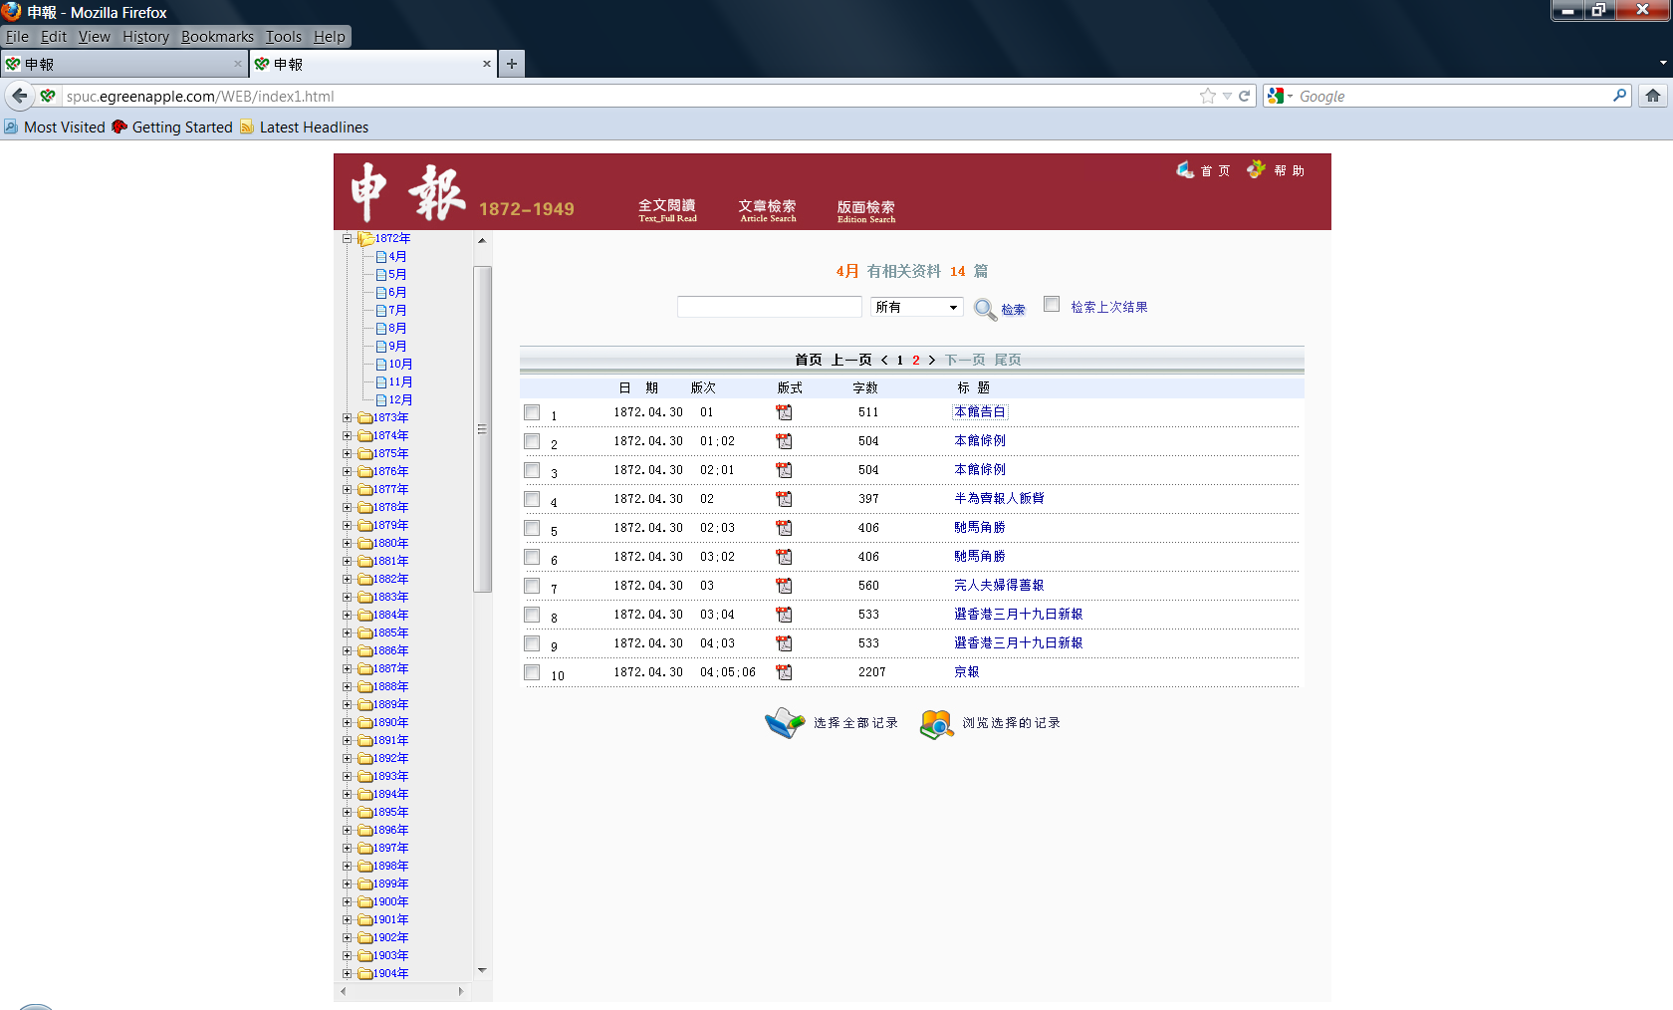
Full-text read

Slide 7
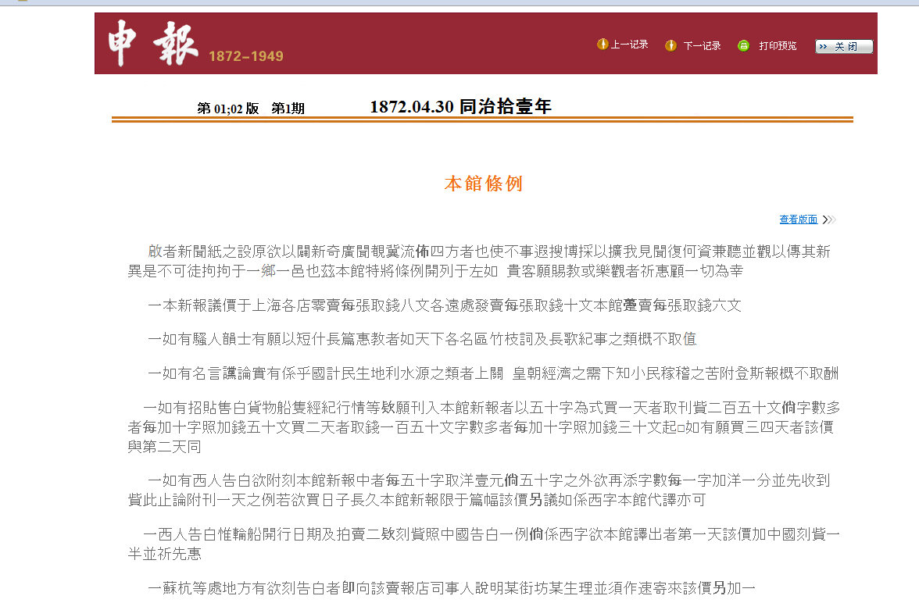
Full-text read - example

Slide 8
Full-text search

Slide 9
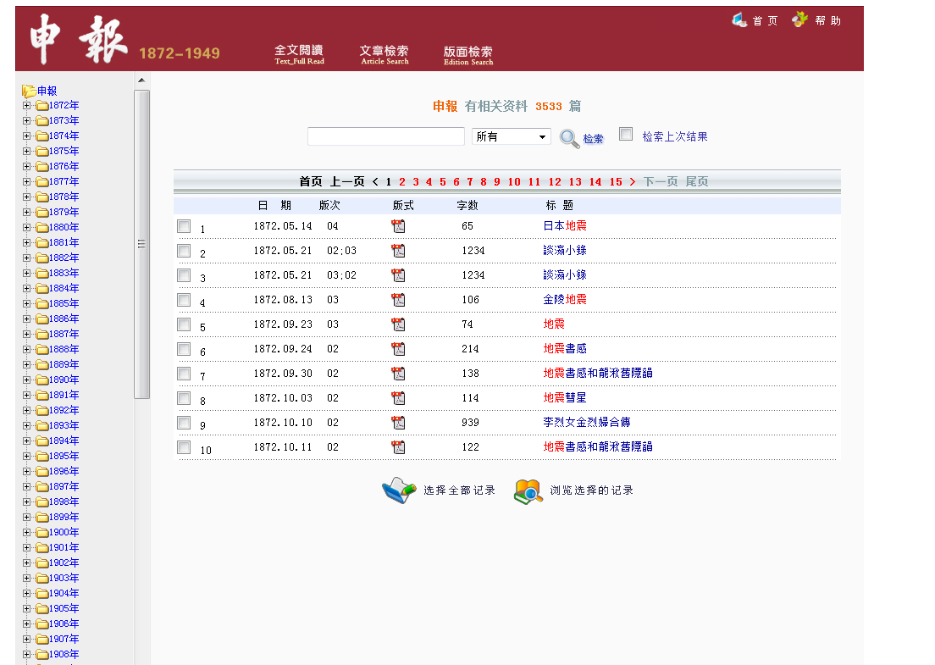
Full-text search - example

Slide 10
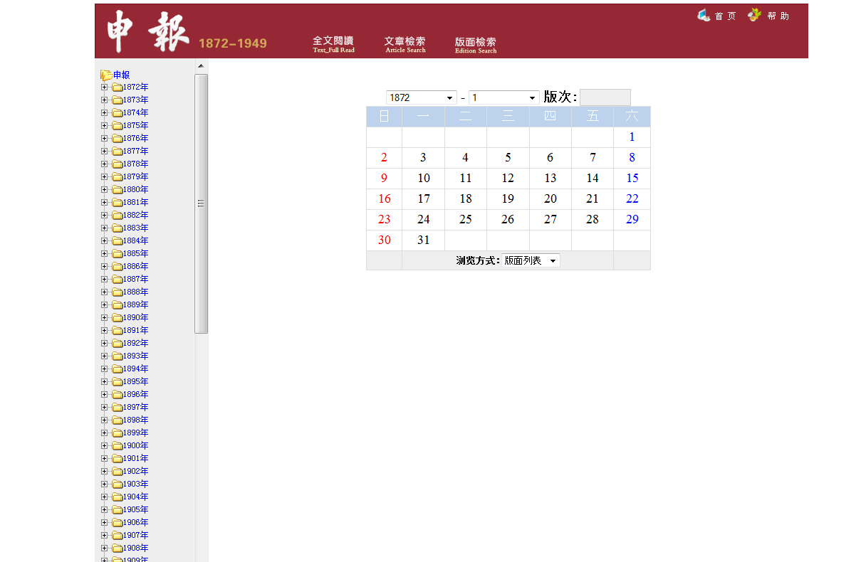
Browse original edition

Slide 11
Browse original edition - example

Slide 12
Advertisement search

Slide 13
Advertisement search - example

Slide 14
Original edition of advertisement

Slide 15
Issues with the database
Different search results using traditional and simplified characters. Example: 立憲 5979 results, 立宪 1 result
Difference version of Shen Bao database has different search results. Green Apple server version: 黃遵憲 54 results; Korean server version 2657 results but the characters of the name are not always together
“Edition search” cannot be searched, only browse
There is no user manual or instruction

