Slide 1
Council on East Asian Libraries Committee on Japanese Materials Meeting “Problems and Concerns for Libraries in Building a Collection of Pop Culture Materials for Research and Teaching”
March 16, 2017
Sheraton Center Toronto Hotel
Dominion North

Slide 2
Updates from CJM
A letter with the list of recommendations to Kokubunken (The National Institute of Japanese Literature) on its “Pre-Modern Japanese Book Database” was submitted, with signatures from 29 Japanese/East Asian Studies librarians, in May 2016.
Professor Osamu Furuse and the Directory of Overseas Collections of Old and Rare Japanese Books, Other Print Materials and Manuscripts

Slide 3
Updates from CJM
Membership Qualification for JpnLibLiaions Revised
“JpnLibLiaisons is open to ANY CEAL members and those who are ALSO currently employed at libraries OR and other NOT FOR PROFIT information organizations and whose job responsibilities are pertinent to Japanese/East Asian Studies collections.” STUDENTS OF LIBRARY SCIENCE OR JAPANESE STUDIES ARE ALSO WELCOME.

Slide 4
CJM: 2014-2017
Michiko Ito (University of Kansas)
Ryuta Komaki (Washington University in St. Louis)
Adam Lisbon (University of Colorado)
Wen-ling Liu (University of Indiana)
Toshie Marra (University of California, Berkeley)
Setsuko Noguchi (Princeton University)
Fabiano Rocha (University of Toronto)
Hamish Todd (British Library)

Slide 5
“Problems and Concerns for Libraries in Building a Collection of Pop Culture Materials for Research and Teaching” Online Survey Report East Asian Pop Culture Collection & Services
Online Survey conducted by CJM
Survey Prepared by Ryuta Komaki (Washington University in St. Louis)
Report by Michiko Ito (University of Kansas)

Slide 6
Survey Summary: Language / Subject Areas

Slide 7
Survey Summary : Roles

Slide 8
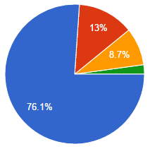
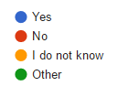
Pop Culture for Research / Teaching Materials
Do your faculty and/or grad students teach courses related to pop culture?

Slide 9
Pop Culture Materials Are Used in . . . .
Language
For reading assignment
Film & Media Studies
Literature
To discuss contemporary literature
Civilization and Culture
Sociology (Gender Studies)
Pop Culture
Art History
Some offer semester-long courses solely focused on: anime, manga, or Korean TV drama

Slide 10
Pop Culture Research Activities by Groups

Slide 11
Undergraduates Use Pop Culture as . . .

Slide 12
Graduates Use Pop Culture as. . .

Slide 13
Faculty Use Pop Culture as. . .

Slide 14
How Pop Culture Materials Are Used for Academic Research – As Main Subject
Development of Original Sound Track (OST) of anime as mainstream
Girls’ Comic
Pokemon
Historical Drama (Taiga Dorama)
Pop Culture Then (60s-70s) and Now

Slide 15
How Pop Culture Materials Are Used for Academic Research – To Explore/Develop Research Subjects
Part of Science Fiction Literature
Chinese Middle Class
Image of Seirā fuku (Sailor style school uniform)
Nuclear Disasters
Japanese Food & Beverage
Communication Methods
Materials can be used by any discipline, including Music, Social Sciences, History, etc.

Slide 16
Librarians Assist them by . . .
acquisition
instruction
Reference to instructors
Reference to students
Never done
Other

Slide 17
Demands Other Than Research/Teaching
Leisure purpose for:
Local community members;
Students’ parents from CJK countries;
Used by anime, manga, game club members
To encourage language students:
Running a pilot test for a CJK popular reading collection aimed at leisure reading or side reader;
For library-wide exhibit;
Collection had been started before teaching and research demands rose.
Meeting the teaching needs is primary. But approx. 10 out of 27 comment how materials are used for other than research and teaching.

Slide 18
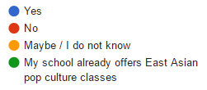
Courses on Pop Culture?

Slide 19
Trends and the Future
My library has received more ILL requests;
Many students studying Japanese language are interested in manga;
We plan to develop our Japanese pop culture collection more since teaching and study interests in Japanese new-wave films, manga, and animated films are increasing;
I think that is the future of Japanese Studies. . . .This is how to draw in students wanting to learn about Japan.

Slide 20
How Can We Support?
When I encounter reference questions, they are usually coming from graduate or undergraduate students. Plus because a solid method or theory based research has not been established for pop culture studies, it is also a challenge for librarians to deal with the topic in academia and support students thoroughly.

Slide 21
Challenges to Collection Development: World of Comics, Too Diverse
Need to rely on suggestions and requests (by patrons);
Unfamiliar with works by new authors
Hard to keep up;
Which is good for different level of language students?
Which title is representative?

Slide 22
No readily available vendor catalogs – Will Catalogs provided by vendors be useful?
“My vendor checks a title against major Korean academic libraries’ catalog before supplying to me to make sure the title is relevant to Korean Studies.”
“. . . [A]ll users have very specific interest (one manga but not another).”

Slide 23
Other Challenges
Lacking English translation (comics) or subtitles (media)
Translated/subtitled editions may be available online, but they are not necessarily legal materials.
Lacking E-comic
“Students requested e-manga, but the libraries could not work with Japanese publishers.”
Most of e-comics are not available for institutions to purchase (exception: Manga Library Z provides out-of-print comics for free: https://www.mangaz.com/)

Slide 24
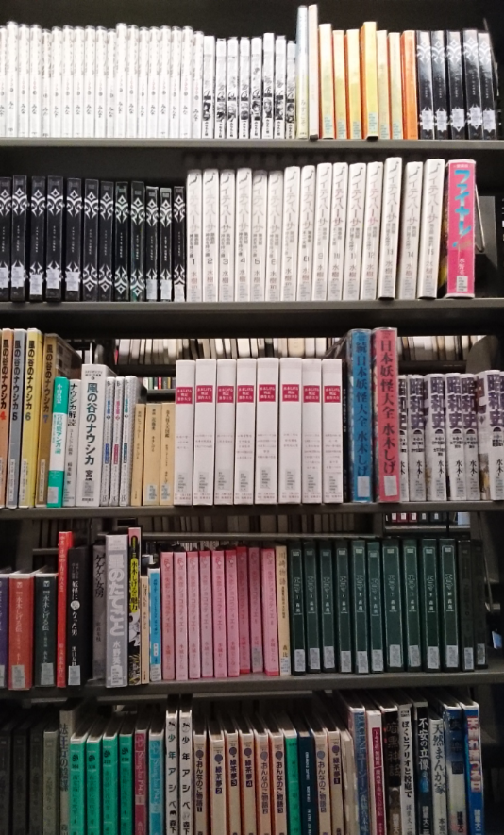
Challenges for Preservation and Access - Comics
Limited shelving space
“I overcame this (somewhat) by designing a newly-freed area of shelving as “East Asia Comics” and making the shelf height lower than in the main collection, thus being able to fit more tankōbon-sized manga and manhwa in that area. . . . This allows for browsing (not having to send the comics to off-site storage because of space-issues) which is really important for students’ access.”

Slide 25
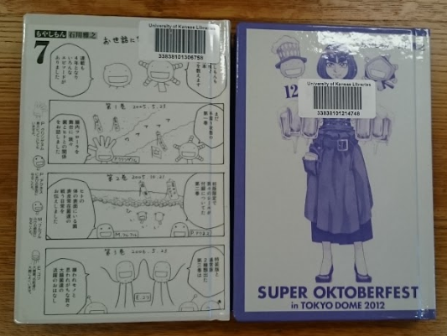
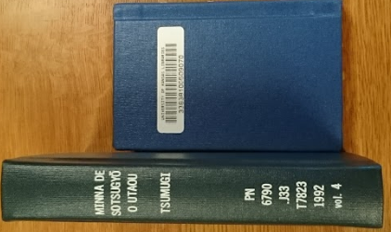
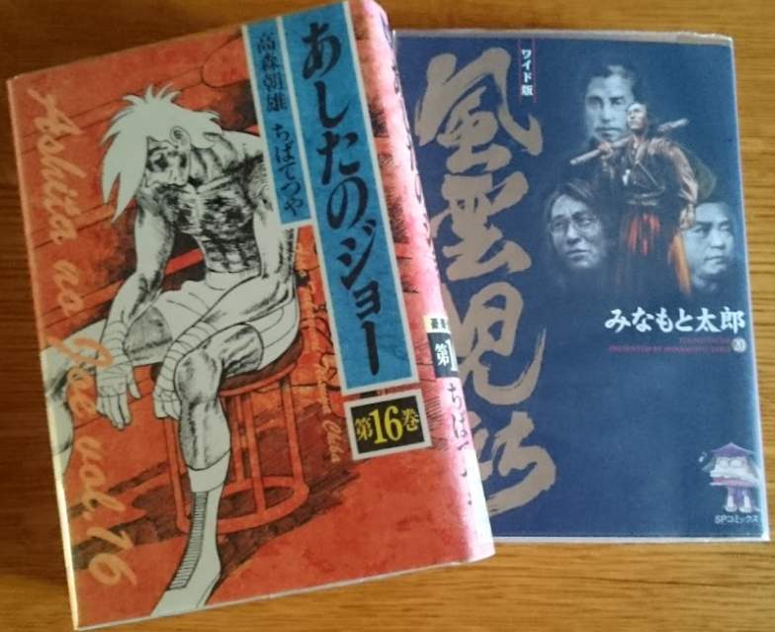
Challenges on Preservation and Access - Comics
Binding may be Costly
Dust jacket protector (for hard cover): $0.73 each + $0.62 labor cost per item
Digi cover: $6.90 each
Regular monograph binding
$4.55-5.70 each

Slide 26
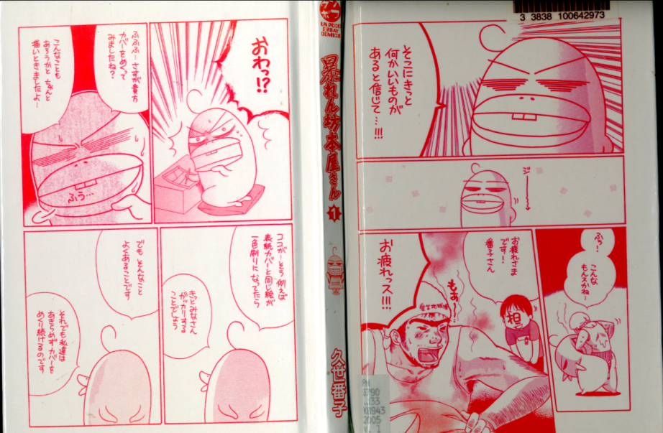
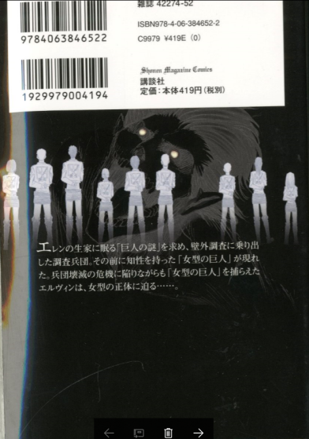
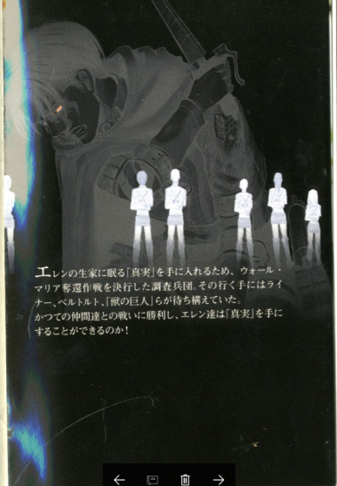
There’s information that’s hard to reproduce on the covers and dust jackets.
Illustrations under the dust jacket
Abarenbō hon’ya-san
Dust jackets, vol. 7 and vol. 20 of
Shingeki no kyojin

Slide 27
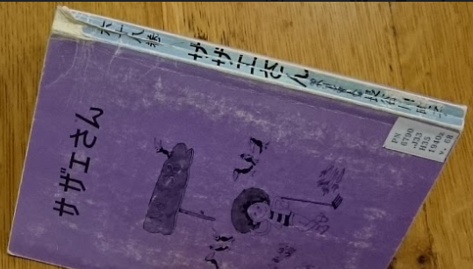
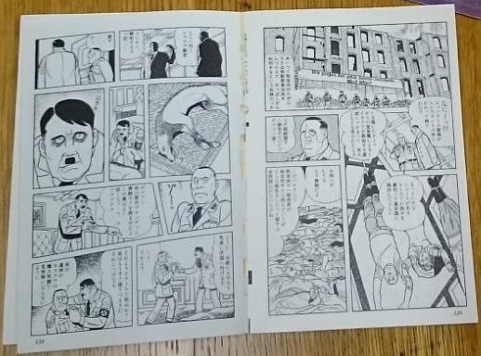
But if not bound, it may be damaged quickly.
When to send them for binding?
“Researcher needs the most current weekly manga immediately.”
Putting on bar code on valuable images.

Slide 28
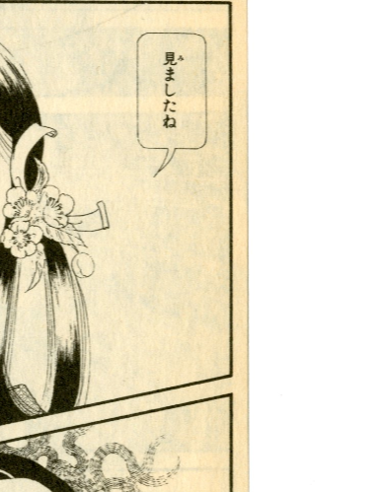
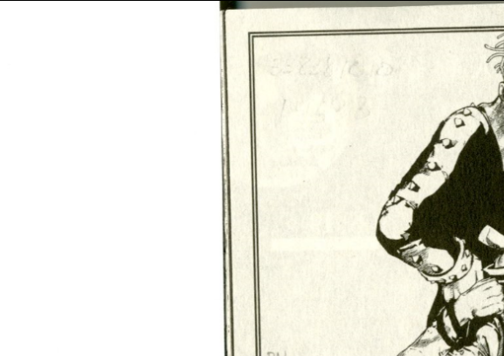
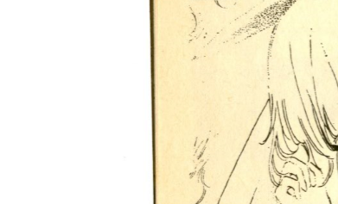
Challenges on Preservation and Access - Comics
Hi izuru tokoro no tenshi, printed 1986
Low quality paper – not for long-time use
Jojorion, printed in 2016
Hamidashikko, printed in 1993
Tōma no shinzō, printed in 1982

Slide 29
We feel that it’s a worthy investment to protect these items with binding upgrades. . .
They aren’t always easy to replace if damaged;
They are highly used in our library and need extra protection;
The paper might not be meant for permanent use, so binding and/or protecting the dust jacket is helpful.

Slide 30
Challenges for Preservation and Access – Media
Challenging to preserve CD, DVD, and video game and providing long-term access to these formats.
VHS format is not usable for lacking of equipment to play, but cannot be replaced:
because of their cost.
Because they are not available in newer format.
Public viewing right is sometimes available, but most of the films are for personal use only;

Slide 31
Availability of Licensed Streaming Video
Our library has asked that we not purchase DVD or Blu-ray since any format is transitive and short-lived.
Very limited availability;
Expensive;
Streaming is very welcome by our patrons; streaming service is costly for the library because the library needs to buy the same films all over again after a year.

Slide 32
Many Materials (videos, comics, articles, etc.) Are Onlined, but Can We Rely on Them?
Web resources are very difficult to collect and preserve;
Some resources are not legally uploaded;
They may be deleted or the are not available in North America.

Slide 33
How Can We Support?
Non-traditional visual media will become more and more important. Information on how to acquire posters, in-crowd magazines, digital-born data (webtoons, blogs etc) and how to curate them is going to be an essential part of the job, and as of yet there is very little support from existing networks for librarians.

Slide 34
Online Survey Summary Will be Available at CJM website.

Slide 35
Dr. Thomas Lamarre
(McGill University)
“The Challenges of Archiving Non-Canonical and Non-Discrete Objects”

