Slide 1
OCLC CJK User Group
Toronto, 15 March 2012
David Whitehair
Senior Product Manager
OCLC
whitehad@oclc.org
Notes:
1
1
1
1
1

Slide 2
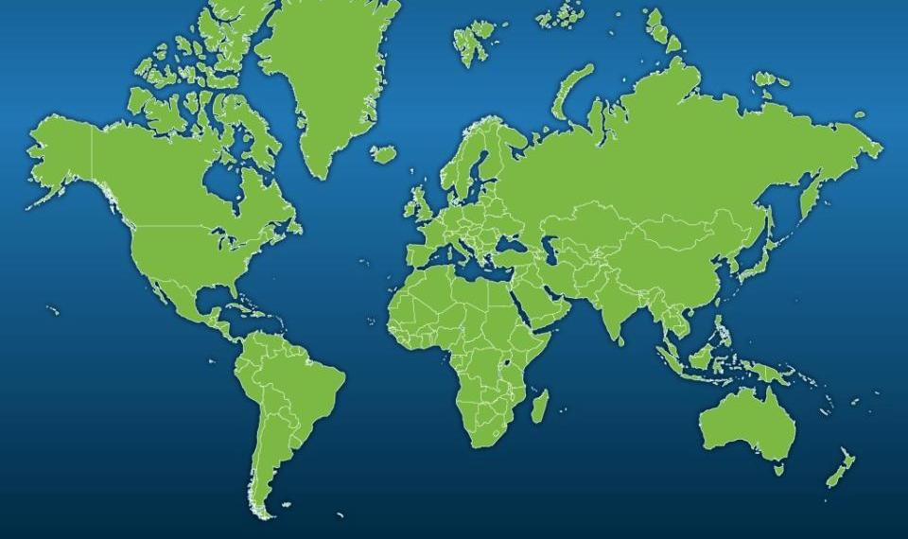
The OCLC cooperative: a nonprofit, membership organization
Public purposes:
Further access to the world’s information
Reduce the rate of rise of library costs
72,035 libraries in 170 countries
Notes:
2
2
2
2
2

Slide 3
OCLC Global Council 2011-2012
Global Council will elect two trustees in April 2012
Notes:
Here is the 2011-2012 OCLC Global Council.
33 of the 48 delegates on the Global Council are from the Americas.
In April, the Global Council will elect two members of the OCLC Board of Trustees.
We at OCLC greatly appreciate the willingness of librarians to get involved in the governance of the cooperative.

Slide 4
Americas Regional Council Meeting
20 January 2012
PHOTO

Slide 5
ARC Executive Committee
Name | Office | Institution | Location
Bill Maes | Chair | Dalhousie University | Canada
Barbara Preece | Vice Chair / Chair-Elect | California State University San Marcos | USA
Claudia Timmann | Secretary | Mohave Community College | USA
Pat Boze | Member-at-Large | Illinois Heartland Library System | USA
Joseph Hafner | Member-at-Large | McGill University Library | Canada
James LaRue | Member-at-Large | Douglas County Libraries | USA
Marilyn Montalvo | Member-at-Large | University of Puerto Rico | Puerto Rico

Slide 6
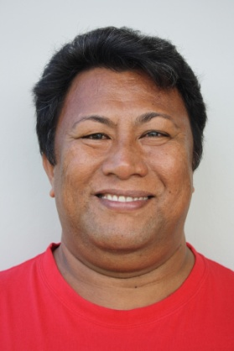
2011-2012 OCLC Asia Pacific Regional Council Executive Committee
ChewLeng Beh
Singapore National
Library Board
Makoto Nakamoto
Waseda University
Avaologo A. Togi Tunupopo
National University of Samoa
Hsueh-hua Chen
National Taiwan University
Peter Sidorko
University of Hong Kong
Andrew Wells
University of
New South Wales
Alison Elliot
National Library
of New Zealand

Slide 7
WorldCat today
258+ million records
1.8+ billion holdings
20 February 2012
Notes:
So, here are the latest statistics from WorldCat.
It is now contains over 256 million bibliographic records and nearly 1.8 billion holdings.
Over 20 million records have been added this fiscal year, which began on July 1, 2011.

Slide 8
WorldCat growth since 1998
Millions of records (as of 30 June 2011)
Notes:
8

Slide 9
Multilingual WorldCat
Total Records
English
German
French
Spanish
Japanese
Chinese
Italian
Dutch
Russian
Latin
235.5 m
97.7 m
33.0 m
21.3 m
9.7 m
7.5 m
5.9 m
3.9 m
3.5 m
3.2 m
3.2 m
58.5%
30 June 2011
Notes:
9
9
9
9
You can see the growth of records in languages other than English.
Eleven years ago, 36 percent of the records in WorldCat were non-English.
Today, 58.5percent of the records are for materials in languages other than English.
WorldCat is indeed a global, Webscale Resource!

Slide 10
Non-Latin scripts in WorldCat
 | January 2012 | 6 Month Growth | 5 Year Growth
Arabic | 728,668 | 24.83% | 675%
Bengali | 353 | 4.13% | 35,200%
Devanagari | 2,974 | 4.76% | 74,250%
CJK | 13,234,450 | 5.91% | 327%
Cyrillic | 647,645 | 31.58% | 4,882%
Greek | 56,479 | 17.10% | 21,539%
Hebrew | 1,529,979 | 29.44% | 2787%
Tamil | 41,377 | 3.31% | 517,113%
Thai | 150,088 | 6.61% | 217,419%

Slide 11
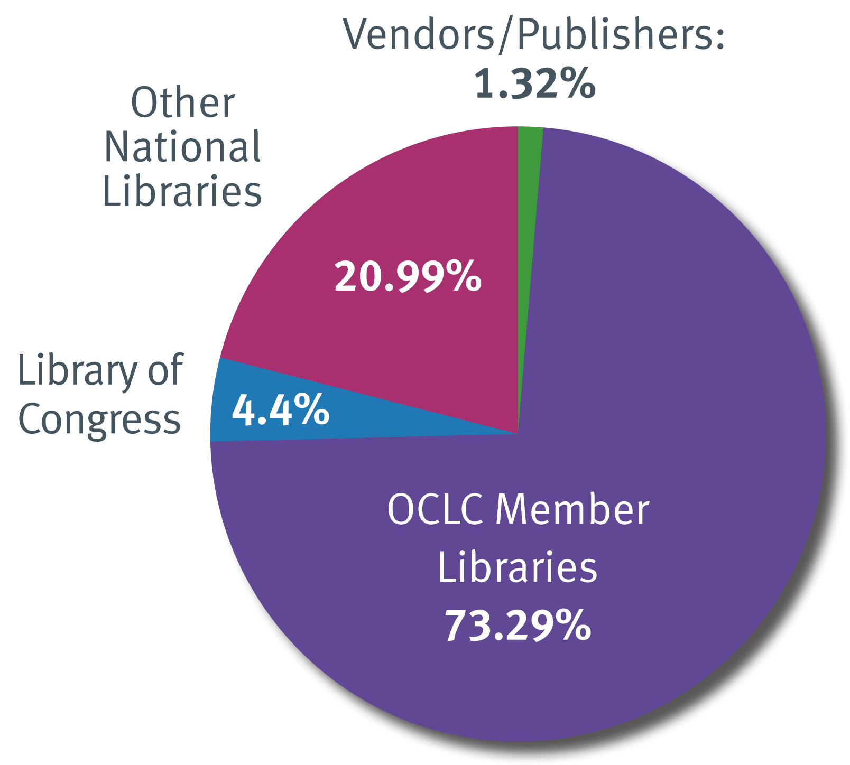
Source of WorldCat records

Slide 12
Recent batchload projects added to WorldCat
Wasada University – 27,931 records processed and 7,125 records added to WorldCat
Thammasat University Library, Thailand -- 562,885 records processed, with 97,705 adds
Nanyang Tech University, Singapore -- 610,516 records processed, with 31,980 adds
Perpustakaan University, Malaysia -- 70,982 records processed, 69,578 adds

Slide 13
National Diet Library
4,979,589 records processed
4,318,453 records added to WorldCat
Quarterly updates since February 2011

Slide 14
CALIS
521,227 records processed
264,648 records added to WorldCat
Chinese publications between 1987 and 2001
OCLC and CALIS will evaluate project after one year
Notes:
Representatives from the China Academic Library and Information System (CALIS) and OCLC signed a memorandum of understanding on October 25, 2011 that led to loading the CALIS records into WorldCat. CALIS is a nationwide academic library consortium with a mission to promote, maintain, and improve resource-sharing among Chinese university libraries and other libraries and institutions.

Slide 16
Connecting the world’s libraries to operate and innovate at Webscale.
Notes:
“Vision without action is a daydream.
Action without vision
Is a nightmare.”
–Japanese Proverb

Slide 17
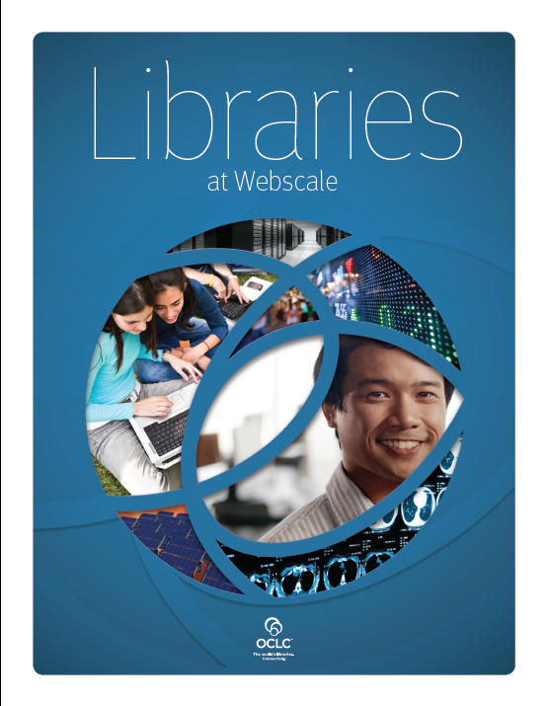
Help libraries operate at Webscale
Notes:
We at OCLC believe strongly that libraries, and OCLC, need to be committed to a future that enables libraries to work together at Webscale.
OCLC recently rolled out the new OCLC WorldShare Platform and brand.
OCLC WorldShare provides a Web-based platform for collective innovation with shared services, integrated applications and a streamlined approach to managing library workflows.
Together with WorldCat, WorldShare helps the world’s libraries connect in new ways to operate, innovate and collaborate at Webscale.
On the screen is “Libraries at Webscale.”
This new report to the membership explores the impact of the Web on our rapidly changing information landscape.
It provides an overview of the opportunities and challenges that operating in a Web-connected world provides for libraries and library users.
You can download a free copy of this report from the OCLC Web site.

Slide 18
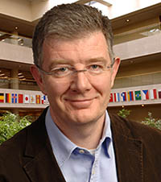
“Operating at Webscale is a strategy bigger than any one service or organization.”
Architect systems and services to scale as use grows
Large gravitational hubs (eBay, Amazon, Google, Wikipedia)
Lorcan Dempsey Vice President, OCLC Research and Chief Strategist
Notes:
As OCLC’s Vice President of Research and Chief Strategist points out, the concept of Webscale is strongly aligned with OCLC’s historic mission of operating a computer network and infrastructure that creates economies of scale, enabling more libraries to reduce costs and share resources.
The network effects of the thousands of OCLC members working together can create a large gravitational hub for the library community and its users.
Libraries are critical contributors to the information landscape, and yet, libraries are still optimized to provide the services at the level of the institution or the communities they serve—the university, college, city, township, school or company.
Libraries are naturally “Institution scale”
But libraries need to increasingly prove their relevance in a “webscale” information ecosystem.

Slide 19
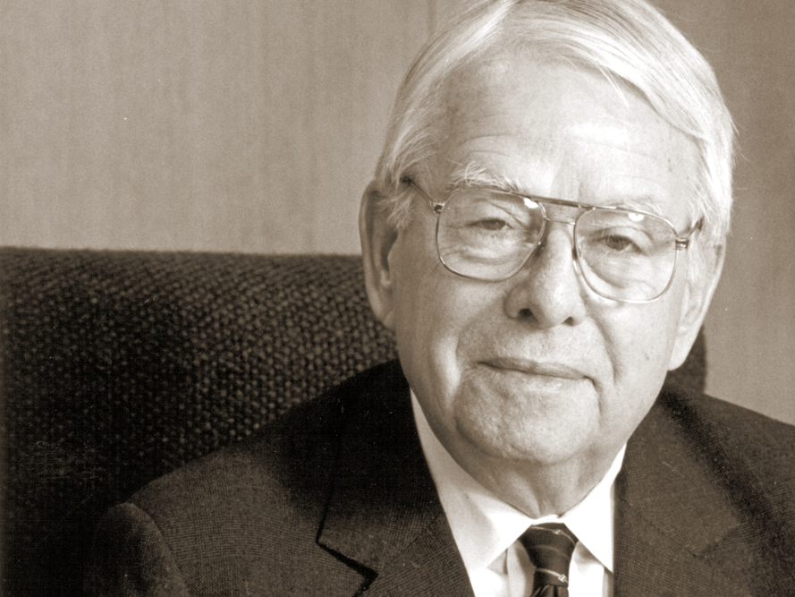
Fred Kilgour’s Strategic Plan—1967
Online union catalog and shared cataloging
Serials control
Technical processing (acquisitions)
Interlibrary loan
Retrieval by subject (reference)
Remote catalog access and circulation control
Notes:
It’s interesting to note that Fred anticipated today’s cloud computing back in 1967.
His original design for the OCLC online system called for the six subsystems listed on screen that would connect libraries to a centralized computer resource.
Libraries would access these subsystems from remote workstations.
The costs of the hardware and software in the cloud—mainframes owned by the OCLC cooperative—would be shared by the members based on their use of the subsystems.
WMS is in many ways the realization of the original design of the OCLC system that Fred envisioned.
While library terminology has changed since 1967, the concept of a library’s having access to a central computing resource without having to make large investments in hardware or software remains the same.

Slide 20
Shared data about the world’s libraries. Find and get it.
Shared infrastructure to manage and share resources across libraries and across communities.
Notes:
OCLC member libraries have worked together for over 40 years to build to world’s largest database of library collections. It’s purpose has been to work with shared data both to improve cataloging efficiencies for libraries but to also increase access to the world’s knowledge held by libraries.
WorldCat represents the shared data about the world’s libraries, connecting library data to other information providers on the open web, ensuring information seekers can find and get the materials and services available in the world’s libraries.
[page down]
Now the cooperative is taking it to the next level with OCLC WorldShare.
WorldShare is the shared infrastructure—that will allow libraries to create, collect, manage and share their resources in new and more efficient ways at Webscale.

Slide 21
Challenges…
Mainstream alternatives to library services
Demand declining for traditional services
New patron demands
Alignment to institutional/
societal goals
Managing down print
E-books at a tipping point
Re-purposing library space
Notes:
1. At the very top level we hear things like….
The existence of mainstream alternatives to library services
Declining demand for traditional services
New patron demands for new services
The need to manage down print collections
The rise of e-Books
We continually hear issues like these
BUT IN REALITY THESE ARE SYMPTOMS. I WOULD SAY THE REAL ISSUE IS… Relevance

Slide 22
Challenges…
Relevance
Ensuring library relevance in an increasingly digital / online/ network level / Webscale world.
Mainstream alternatives to library services
Demand declining for traditional services
New patron demands
Alignment to institutional/
societal goals
Managing down print
E-books at a tipping point
Re-purposing library space
Notes:
1. Relevance
2. How do libraries ensure their enduring relevance in a
Digital / Online / Networked / Webscale World…
A second family of issues are things like….

Slide 23
Challenges…
Relevance
Ensuring library relevance in an increasingly digital / online/ network level / Webscale world.
Library funding
Budget pressures
Global economy
Re-deploying library staff
Outsourcing
Notes:
Funding…
Budgets…
Economic issues…
A lot of people mention these first.
I put these second, because I think if we really had a good answer to the relevance issue then some (not all) of these would go away…
You could wrap these issues in something like… Efficiency

Slide 24
Challenges…
Relevance
Ensuring library relevance in an increasingly digital / online/ network level / Webscale world.
Efficiency
Maintaining, improving and transforming library services in an era of sustained downward budget pressure.
Library funding
Budget pressures
Global economy
Re-deploying library staff
Outsourcing
Notes:
These 2 challenges override everything….
RELEVANCE AND EFFICIENCY
Within these however, you hear more detailed and focused sets of challenges…

Slide 25
Challenges…
Relevance
Ensuring library relevance in an increasingly digital / online/ network level / Webscale world.
Efficiency
Maintaining, improving and transforming library services in an era of sustained downward budget pressure.
Users start in Google / Google Scholar
Discovery starts outside the library
Getting in user workflows
Exposure of library services
Syndicating library data
Notes:
1. There are a set of issues all spinning around the challenge of getting in users’ workflows…
2. We know users really start in Google, or Google Scholar – how do we get them in to the library from there….
3. OR MORE GENERALLY
How do we present library services in user workflows.
How do we embed and syndicate library services to the environments where users are….
Lots of different ways of saying the same thing….

Slide 26
Challenges…
Relevance
Ensuring library relevance in an increasingly digital / online/ network level / Webscale world.
Efficiency
Maintaining, improving and transforming library services in an era of sustained downward budget pressure.
Meeting users at the point of need
Present users with the library services they need within their mainstream workflows.
Users start in Google / Google Scholar
Discovery starts outside the library
Getting into user workflows
Exposure of library services
Syndicating library data
Notes:
1. How do we meet users at their point of need with library services….
2. You can use all sorts of fancy terminology for this, but we all understand what we mean – we must be able to present library services in the online places where users are…
Next we hear things about the changing nature of collection management. Typical challenges are things like…

Slide 27
Challenges…
Relevance
Ensuring library relevance in an increasingly digital / online/ network level / Webscale world.
Efficiency
Maintaining, improving and transforming library services in an era of sustained downward budget pressure.
Meeting users at the point of need
Present users with the library services they need within their mainstream workflows.
Breaking down resource silos
Licensed resource workflows
Managing learning objects
Digital integration / mass digitization
Managing down print
Notes:
1. Silo’ed resource management
2. The difficulty of managing licensed resources
3. At a detailed level we hear significant issues around how do we provide management to the growing number of learning objects currently embedded in learning management systems…
4. The need to integrate with digitization activities and the impact of those on local collections
5. And then again of course there is the challenge of Managing down print…
Etc.
Again, all these could be consolidated into something like…. Unified Collection Management

Slide 28
Challenges…
Relevance
Ensuring library relevance in an increasingly digital / online/ network level / Webscale world.
Efficiency
Maintaining, improving and transforming library services in an era of sustained downward budget pressure.
Meeting users at the point of need
Present users with the library services they need within their mainstream workflows.
Unified Collection Management
Efficiently manage a collection spanning print, electronic and digital material.
Breaking down resource silos
Licensed resource workflows
Managing learning objects
Digital integration / mass digitization
Managing down print
Notes:
Efficiency… across print, licensed and digital
The next set of things we hear were starting to move towards a solution

Slide 29
Challenges / Opportunities…
Relevance
Ensuring library relevance in an increasingly digital / online/ network level / Webscale world.
Efficiency
Maintaining, improving and transforming library services in an era of sustained downward budget pressure.
Meeting users at the point of need
Present users with the library services they need within their mainstream workflows.
Unified Collection Management
Efficiently manage a collection spanning print, electronic and digital material
Increased Collaboration
Shared Services
Economies of Scale
Accelerated Innovation
Shared
Innovation
Notes:
1. The challenges are underpinned by the OPPORTUNITY to support greater collaboration and innovation.
2. These are really moving towards a solution, but they seem to underpin everything…
3. The need for new forms of collaboration
4. The need to increase innovation – by sharing
5. The need to leverage economies of scale
TRANSITION: So, again you can summarize these as …

Slide 30
Challenges / Opportunities…
Relevance
Ensuring library relevance in an increasingly digital / online/ network level / Webscale world.
Efficiency
Maintaining, improving and transforming library services in an era of sustained downward budget pressure.
Meeting users at the point of need
Present users with the library services they need within their mainstream workflows.
Unified Collection Management
Efficiently manage a collection spanning print, electronic and digital material.
Collaboration & Innovation
Support greater collaboration and innovation between libraries.
Increased Collaboration
Shared Services
Economies of Scale
Accelerated Innovation
Shared
Innovation
Notes:
1. The challenge to support greater collaboration and innovation…
2. So this gives an overall map of how we might think about the challenges we are facing.
SO THIS IS A MAP OF THE CHALLENGES , HOW DO WE MAP OUR STRATEGIC INITIATIVES

Slide 31
Strategic Response…
Relevance
Ensuring library relevance in an increasingly digital / online/ network level / Webscale world.
Strategic Initiative to collaboratively build Webscale with lbraries.
Increase the relevance and visibility of libraries in a ‘Webscale’ world
Increase efficiencies and reduce costs.
Efficiency
Maintaining, improving and transforming library services in an era of sustained downward budget pressure.
Meeting users at the point of need
Present users with the library services they need within their mainstream workflows.
Unified Collection Management
Efficiently manage a collection spanning print, electronic and digital material.
Collaboration & Innovation
Support greater collaboration and innovation between libraries.
Notes:
1. This is really aimed at ‘Collaboratively building Webscale with libraries”
2. Making libraries as a whole visible and relevant in a “Webscale” world.
3. ALSO EFFICIENCIES
ABSOLUTELY PLAYS TO RELEVANCE AND EFFICIENCY.
Within this there are 3 key programs….

Slide 32
Strategic Response…
Relevance
Ensuring library relevance in an increasingly digital / online/ network level / Webscale world.
Strategic Initiative to collaboratively build Webscale with libraries.
Increase the relevance and visibility of libraries in a ‘Webscale’ world
Increase efficiencies and reduce costs.
Efficiency
Maintaining, improving and transforming library services in an era of sustained downward budget pressure.
Meeting users at the point of need
Present users with the library services they need within their mainstream workflows.
Unified Collection Management
Efficiently manage a collection spanning print, electronic and digital material.
Provide Webscale data, discovery and syndication services.
Collaboration & Innovation
Support greater collaboration and innovation between libraries.
Notes:
1. Firstly – The WorldCat Program
2. Massive data aggregation and then exposure and syndication – this is a fundamental tenet of webscale
The Data aggregation, discovery and syndication program
WorldCat, WorldCat.org and WorldCat Local
These are all aimed at presenting the library as broadly and prominently as possible within users’ workflows on the web….
This is a Webscale activity.
Then we have…

Slide 33
Strategic Response…
Relevance
Ensuring library relevance in an increasingly digital / online/ network level / Webscale world.
Strategic Initiative to collaboratively build Webscale with libraries.
Increase the relevance and visibility of libraries in a ‘Webscale’ world
Increase efficiencies and reduce costs.
Efficiency
Maintaining, improving and transforming library services in an era of sustained downward budget pressure.
Meeting users at the point of need
Present users with the library services they need within their mainstream workflows.
Unified Collection Management
efficiently manage a collection spanning print, electronic and digital material
Provide Webscale data, discovery and syndication services.
Offer Webscale management of library services across Print, Licensed & Digital.
Collaboration & Innovation
Support greater collaboration and innovation between libraries.
Notes:
1. The WorldShare Management Services (WMS) – which of course includes the discovery and syndication services
2. This is aimed at bringing network effects and hence dramatic efficiencies to management of print, licensed and digital material.
And then lastly, the area which I think is the key to whole program is the WorldShare Platform.

Slide 34
Strategic Response…
Relevance
Ensuring library relevance in an increasingly digital / online/ network level / Webscale world.
Strategic Initiative to collaboratively build Webscale with libraries.
Increase the relevance and visibility of libraries in a ‘Webscale’ world
Increase efficiencies and reduce costs.
Efficiency
Maintaining, improving and transforming library services in an era of sustained downward budget pressure.
Meeting users at the point of need
Present users with the library services they need within their mainstream workflows.
Unified Collection Management
efficiently manage a collection spanning print, electronic and digital material
Provide Webscale data, discovery and syndication Services.
Offer Webscale management of library services across Print, Licensed & Digital.
Collaboration & Innovation
Support greater collaboration and innovation between libraries.
Collaboration & Innovation
Support greater collaboration and innovation between libraries.
Support library collaboration and innovation at scale, by providing an open, Webscale technical infrastructure.
Notes:
The WorldShare Platform underpins all the other programs.
It provides the underlying infrastructure to support collaboration and “collaborative innovation” at scale on the web for libraries…
So that is how OCLC’s strategic response lines up to the challenges we see.
Because the core of this strategy is the WorldShare platform, I am going to talk though that in a little more detail – to try to explain what it is….
So, WHAT IS THE WORLDSHARE PLATFORM

Slide 35
Strategic Initiative to Collaboratively build Webscale with Libraries.
Increase the relevance and visibility of libraries in a ‘Webscale’ world
Increase efficiencies and reduce costs.
The core infrastructure underlying all OCLC applications.
Designed from the ground up for Webscale operations
App Gallery
Webscale Data, Discovery and Syndication Services
Webscale management of library services across Print, Licensed & Digital
Open to the community to enable
“Collective Innovation” and sharing
Platform Management
Web Services
Collaboration & Innovation
Support greater collaboration and innovation between libraries.
Support library collaboration and innovation at scale, by providing an open, Webscale technical infrastructure.
Data
Infrastructure
Notes:
1. IN a NUTSHELL, It’s the infrastructure underlying all our applications and services.
2. The WorldShare platform is designed from the ground up to operate at Webscale – WHICH IS DIFFICULT.
3. The key point is – this infrastructure is Opened up to community to enable innovation and sharing
4. It really has 4 core components:
The core computing infrastructure
The data aggregation – the extended view of WorldCat
Web Services
Lastly co-ordinating infrastructure to bring all this together into a usable platform environment.
The next few slides go into each of these layers in a little bit of details…
FIRST

Slide 36
Data Centers Today:
App Gallery
US2
EMEA 1
US1
Platform Management
Web Services
Data
600Tb of online storage
4,000 virtual machines
High resilience
Geographically distributed for legal, data protection and performance reasons
Infrastructure
Notes:
1. This is the Computing infrastructure we run today:
3 Data Centers fully online from where we can support WorldCat and WorldShare Platform services.
2 in US, 1 in Europe (came live in November)
But this is just the start.

Slide 37
Infrastructure
Data Centers Planned
CAN 1
US2
EMEA 1
US1
Partner 1
EMEA 2
Additional data centers
Partner-managed data centers
APAC 1
Notes:
We will add:
An Australian Node – serving the APAC region
A Canadian node – for Canada (Patriot act)
A second EMEA node – for greater resilience and performance in Europe
And lastly, which is significant, the ability for partners

Slide 38
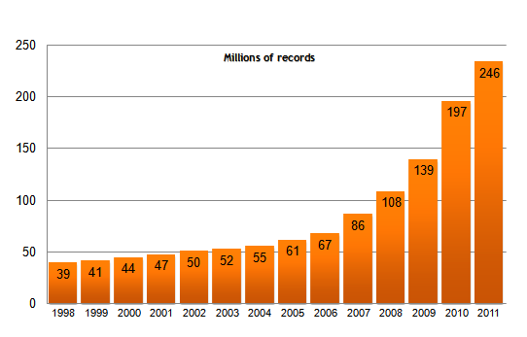
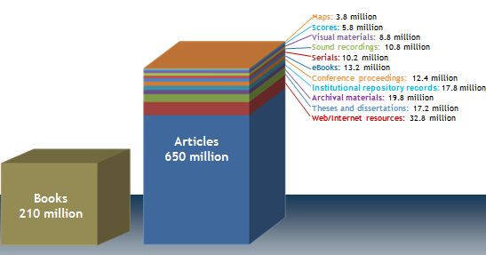
250M+ Bib Records
Flexible, open platform for the community to share applications and innovation
Print
1.8Bn+ Holdings
App Gallery
650M Articles
13M+ eBooks
Licensed
Platform Management
10M KB Entries
Web Services
Digital
40M Digital Items
Data
Infrastructure
Notes:
1. There are many ways of describing the aggregation of data that OCLC manages and we already discussed some of this in the WorldCat slides.
What is interesting is to look at how this data aggregation is managed on the platform…

Slide 39
WorldCat Web Services
Acquisitions Web Services
Flexible, open platform for the community to share applications and innovation
Knowledge base Web Services
Circulation Web Services
App Gallery
WorldCat Registry Web Services
Vendor Information Web Services
Platform Management
Web Services
WorldCat Identities Web Services
Web Services
OpenURL Web Services
Identifier Web Services
Data
QuestionPoint knowledge base Web Services
Infrastructure
Notes:
Here are the families of Web-Services that are exposed in the WorldShare Platform:
One example is the WorldCat Search API as part of the WorldCat Web Services.
On the right-hand-side there are more business logic services such as Acquisitions and Circulation.
THE LAST COMPONENT OF THE PLATFORM IS THE PLATFORM MANAGEMENT ENVIRONMENT – THE INFRASTRUCTURE THAT BRINGS THIS ALL TOGETHER AS A COHERENT WHOLE

Slide 40
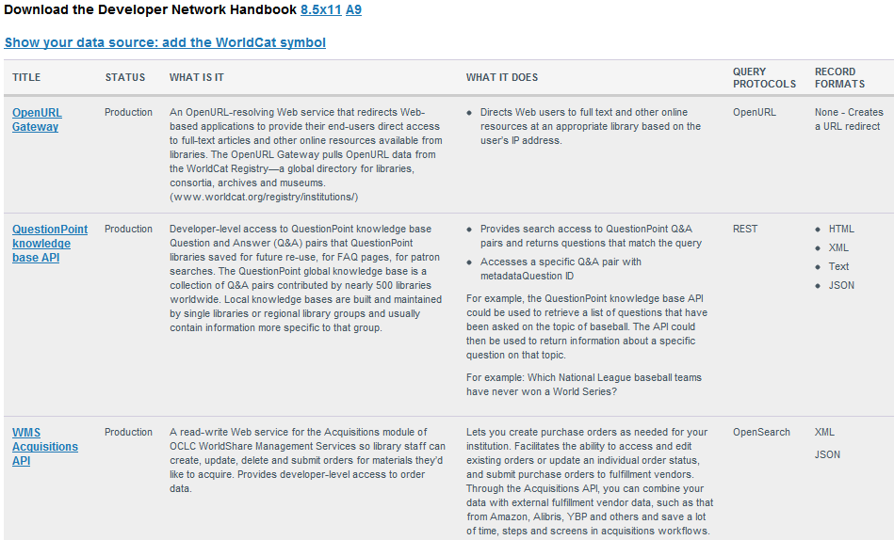
1. A “toolbox” for developers who want to use OCLC services and data to build new or enhance existing applications
Flexible, open platform for the community to share applications and innovation
App Gallery
Platform Management
Web Services
Data
Platform Management
Infrastructure
Notes:
1. As a developer you get a toolbox”
2. Documentation on all the web services
3. Example code etc…
4. TRANSITION – As a library and/or developer you get…

Slide 41
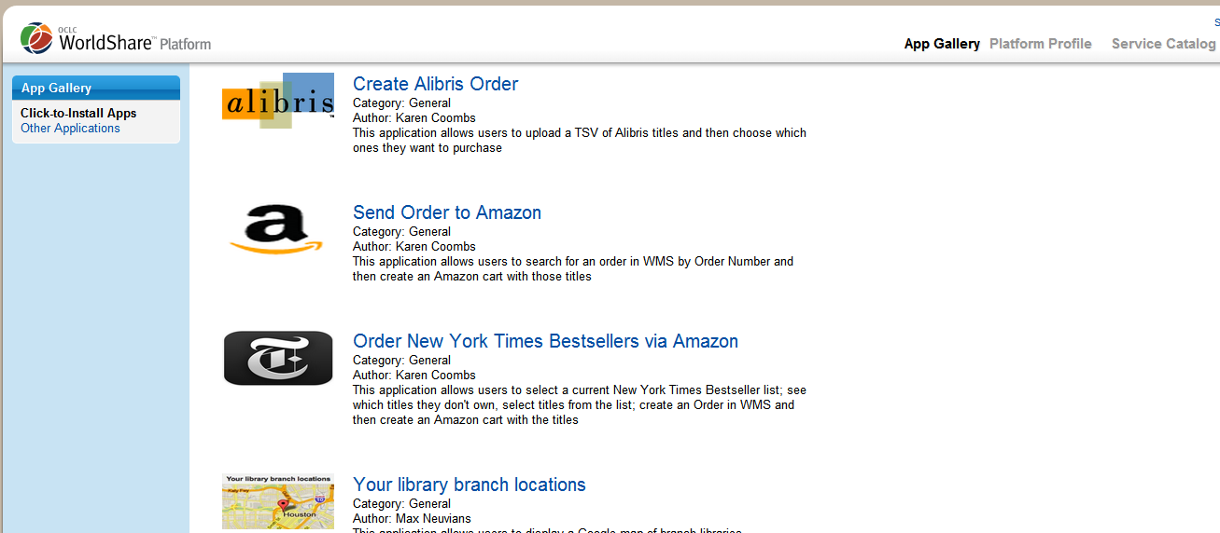
Platform Management
2. An “App Gallery” through which libraries can easily share apps created by the community.
Notes:
An App Gallery…
Far more important to libraries
90% of libraries aren’t going to develop - consumers
TRANSITION : AND LASTLY

Slide 42
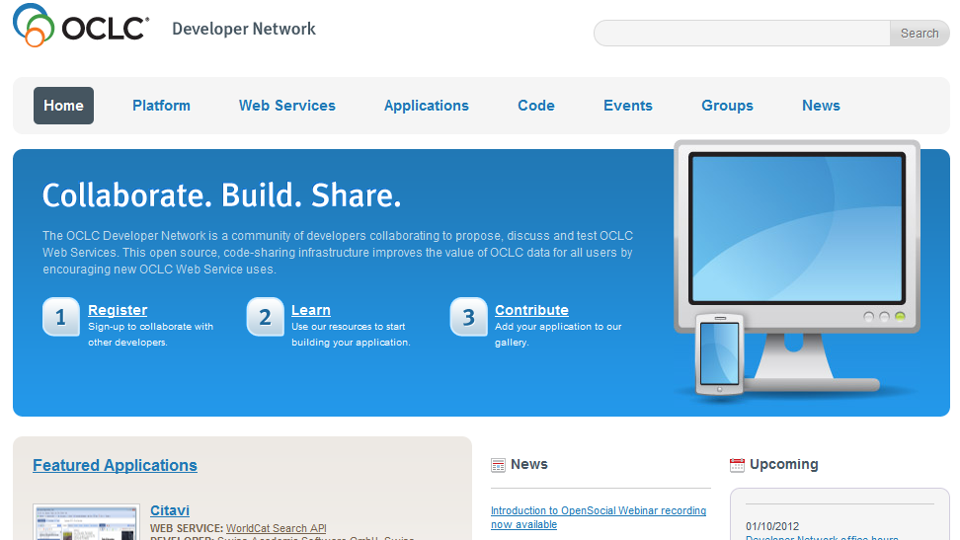
Platform Management
3. Support for collaboration and cooperation within the library community
Flexible, open platform for the community to share applications and innovation
Notes:
AND LASTLY OF COURSE, a collaboration environment….

Slide 43
Applications/Apps…
BASIC PRINCIPLE: ANYONE can develop on the WorldShare Platform
Flexible, open platform for the community to share applications and innovation
OCLC-built Applications
Library-built Applications
Partner-built Applications
OCLC creates an app
A library developer creates an app
A third party creates an app
Many happy libraries will consume all three without ever having to do anything!
App Gallery
Platform Management
Web Services
Data
Infrastructure
Notes:
Anyone can develop on the WorldShare Platform.
[page down]
1. OCLC builds applications
[page down]
2. Libraries can build and share applications
[page down]
3. Partners can build applications….
[page down]
4. The key point is that ANYONE can develop applications…
Just think of the possibilities for Connexion client macros if such a platform existed when Connexion was developed!

Slide 44
WMS: What is included?
Acquisitions for physical and electronic collections – all available in one service
Circulation and patron management for the 21st century – handled centrally using a simple, web-based interface
Discovery and delivery as users expect it – with WorldCat Local’s single search interface
Cataloging tools for data creation and enrichment – powered by WorldCat
The WorldCat knowledge base – combining data about your library’s electronic resources and linking features
WMS Reporting – canned reports and simple query tool

Slide 46
Cataloging news
RDA
Connexion
Notes:
Now for a few cataloging-specific topics…

Slide 47
RDA recent changes
Indexing changes
Entity attribute (en:) index (Bibliographic records)
046 ‡k ‡l
380 ‡a
381 ‡a
382 ‡a
383 ‡a ‡b ‡c
384 ‡a
Links from Connexion client & browser to the RDA Toolkit
Notes:
Now for a few cataloging-specific topics…

Slide 48
What’s coming …
RDA Workforms
Set a preference in the Connexion client or browser
Record matching changes
Fully incorporating RDA changes
Additional validation rules to insure correct coding
Additional MARC format changes (MARC Update No. 13)
Notes:
RDA workforms:
Client – March/April
Browser – May
Record matching: on-going
MARC Update 13: tentatively spring 2012

Slide 49
MARC format changes
Bibliographic
264 Production, Publication, Distribution, Manufacture, and Copyright Notice
344 Sound Characteristics
345 Projection Characteristics of Moving Image
346 Video Characteristics
347 Digital File Characteristics
377 Associated Language
Additional subfields in field 340 and 383
Authority
368 Other Corporate Body Attributes
378 Fuller Form of Personal Name
Additional subfields in field 377 and 384
Notes:
Emphasize that field 264 is a major implementation affecting indexing, record matching, and display …

Slide 50
Policy review
Incorporating RDA practices into WorldCat dicussion paper laying out potential policies and actions
http://www.oclc.org/rda/
Comments due April 15, 2012
Send to rdapolicy@oclc.org

Slide 51
Global Library Manifestation Identifier (GLIMIR)
The GLIMIR manifestation identifier clusters parallel records together (differing languages of cataloging for the same manifestation)
WorldCat is not yet completely “GLIMIRized”, but process is underway

Slide 52
Connexion without GLIMIR option

Slide 53
Same search with GLIMIR option
Notes:
The record with the most holdings in each cluster is the representative record displayed on the list. My library has holdings on one record in the second cluster, but not OCLC #3625701.

Slide 54
GLIMIR cluster
Notes:
My library has holdings on #695900531.

Slide 55
Cluster holdings information displays on each bibliographic record
Notes:
My library does not have holdings on this record, but does have holdings on a record in this cluster.

Slide 56
Classify Numeric Search
Notes:
Record did not have call number.
Client asked Classify to search
Classify got single hit on OCLC control#
Client pasted call number in 090 field automatically

Slide 57
Classify Title/Author Search
Notes:
No match in classify for OCLC control#
Record has no standard numbers to check.
Client asks if you want to search in Classify
Say yes and Classify search opens with title populated

Slide 58
Macros
GenerateERecord
Converts print records into provider neutral e-records. Replaces former OCLC macros GenerateESerial and GenerateESerialCONSER
GetClassNumberDeletes command
Sends standard numbers (OCLC control number, ISBN, ISSN, UPC, LCCN) in the displayed bibliographic record to the Classify Web service for matching (in the order listed) and extracting a Dewey classification number

Slide 59
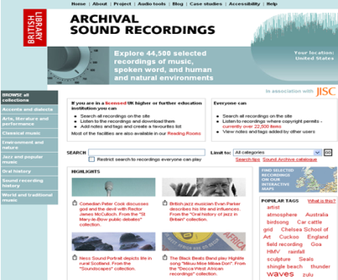
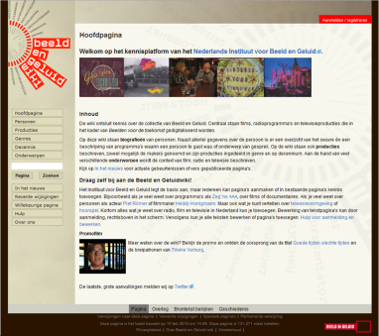
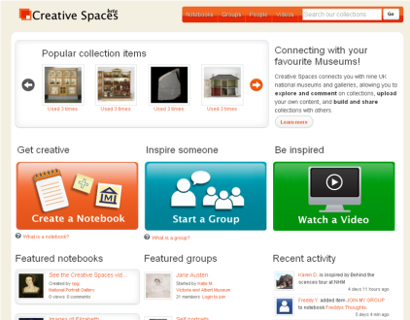
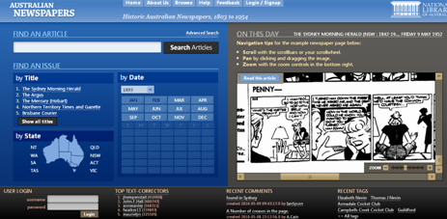
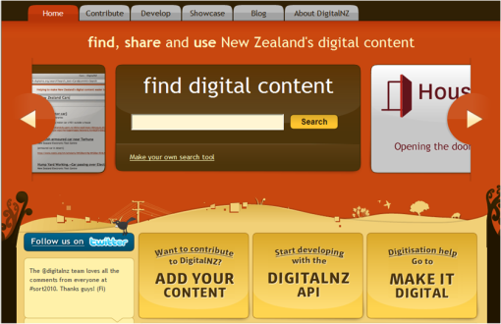
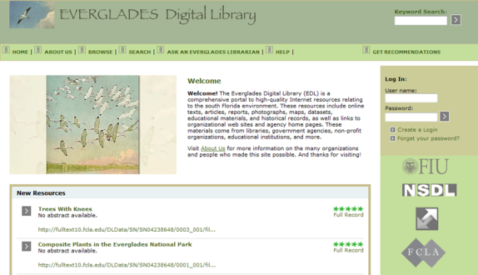
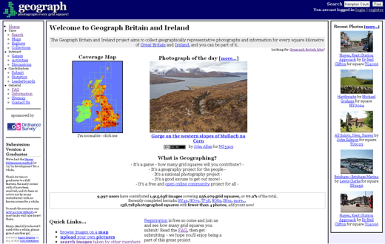
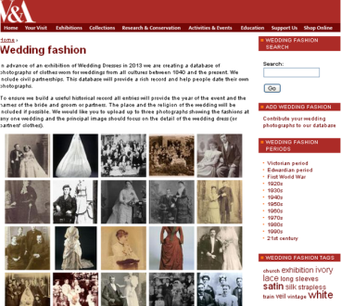
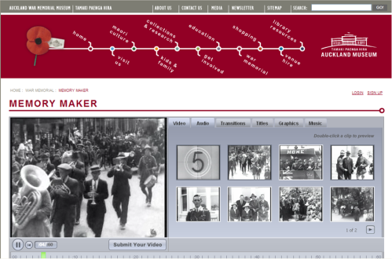
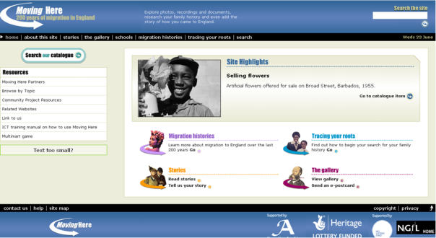
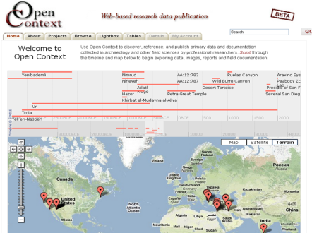
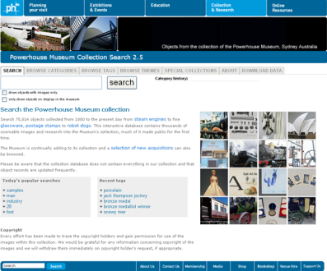
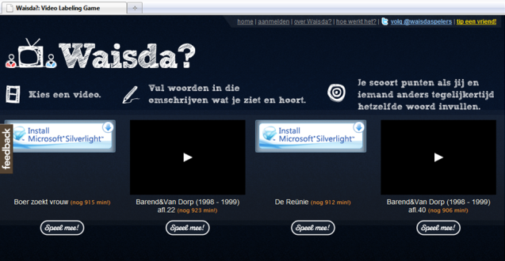
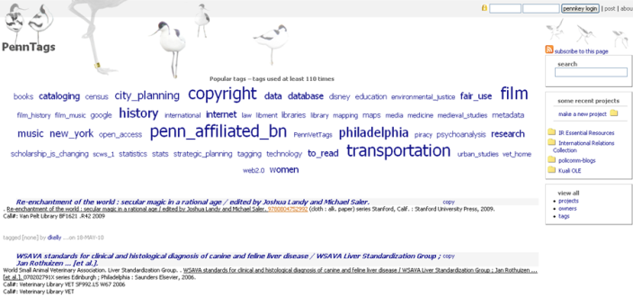
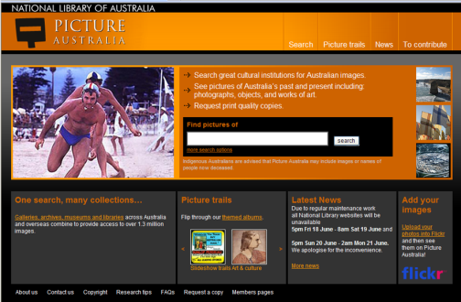
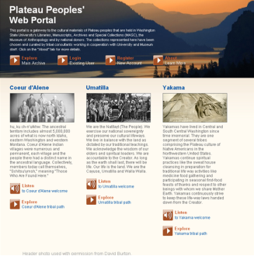
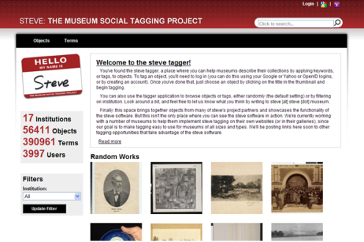
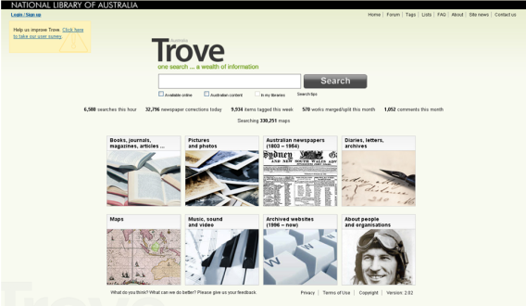
Social Metadata for Libraries, Archives, & Museums

Slide 60
Social Metadata for LAMs
User-generated content that helps us understand and evaluate the resources described by libraries, archives and museums.
Includes: annotations, audio, comments, images, links, lists, ratings, recommendations, reviews, tagging, text editing, video.
OCLC Research Library Partnership eager to take advantage of users’ expertise to enrich their descriptive metadata and expand reach into user communities.
Social Metadata Working Group: 21 OCLC RLP staff from five countries conducted research 2009-2010.

Slide 61
Social Metadata Working Group
Reviewed 76 sites relevant to LAMs that supported social media features.
Looked at LAMs’ use of third-party sites (blogs, Facebook, Flickr, Twitter, Wikipedia, YouTube)
Conducted survey of site managers (40% of respondents outside the U.S.).
Interviewed managers, read literature, synthesized results, made recommendations.

Slide 62
Results
Three reports and executive summary (Social Metadata for Libraries, Archives and Museums)
18 recommendations
All reports, presentations on OCLC Research website, Sharing and aggregating social metadata
www.oclc.org/research/activities/aggregating
For more information, contact:
Karen Smith-Yoshimura, smithyok@oclc.org

Slide 63
Questions?
Notes:
63
63
63

